Slide 1
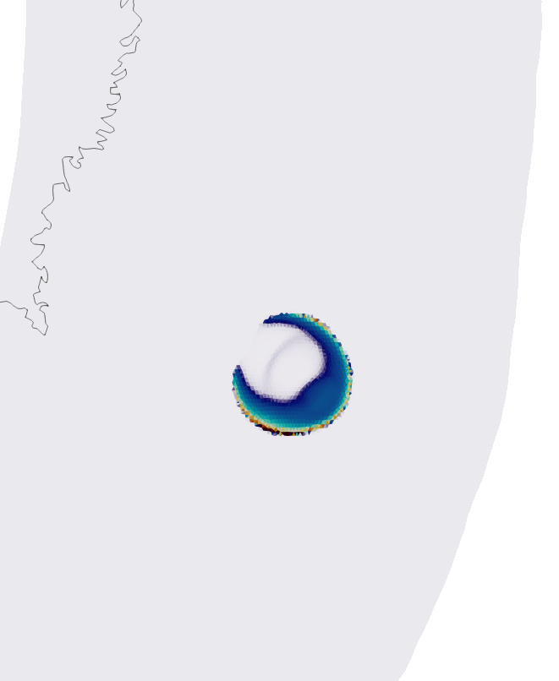
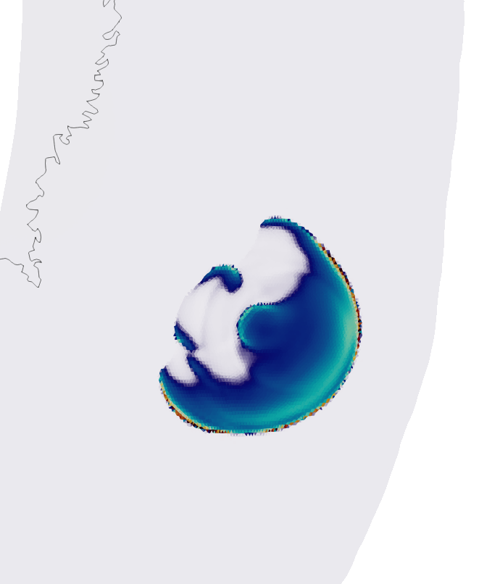
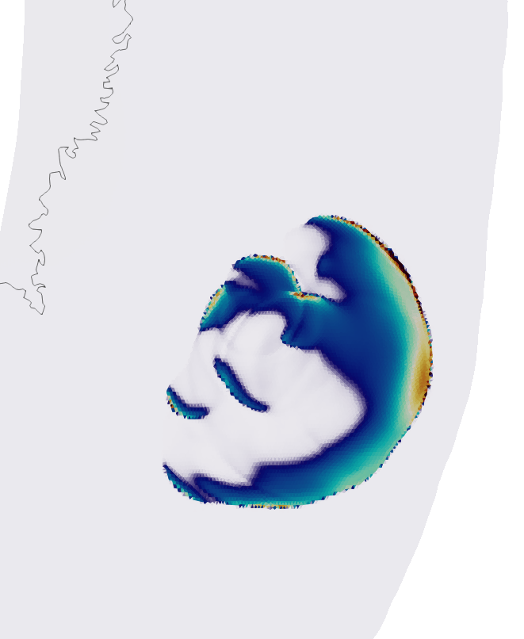
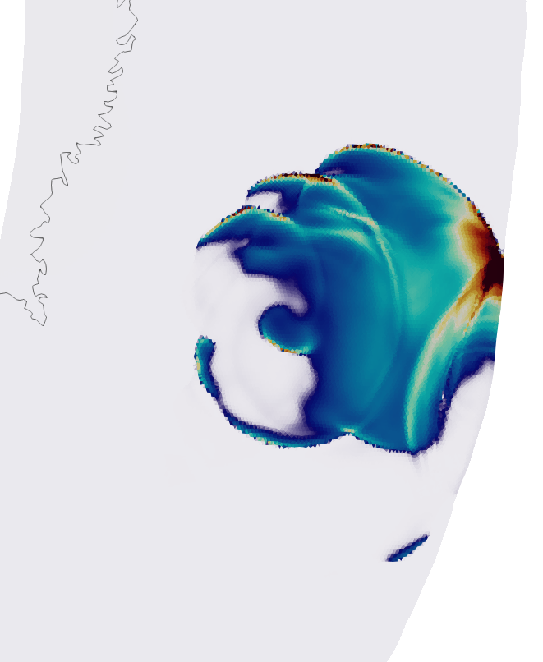
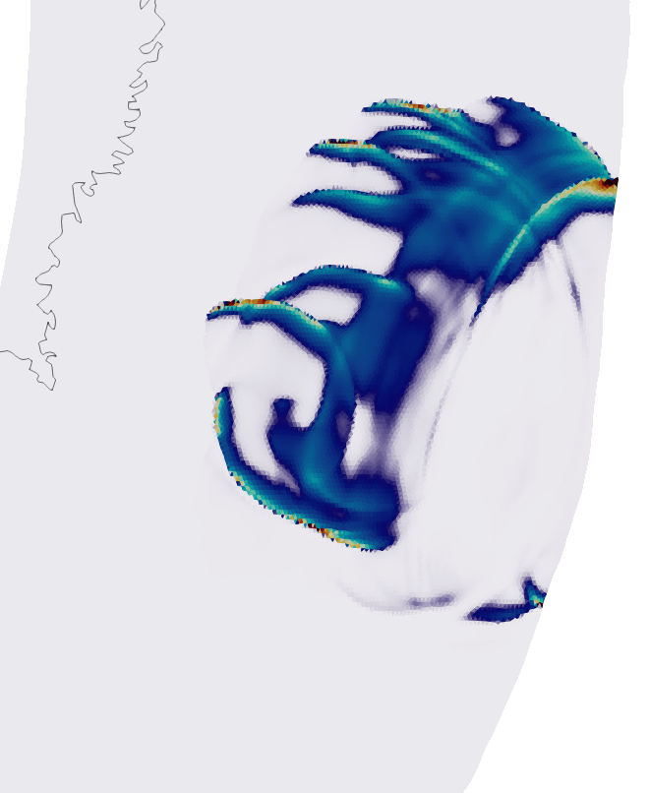
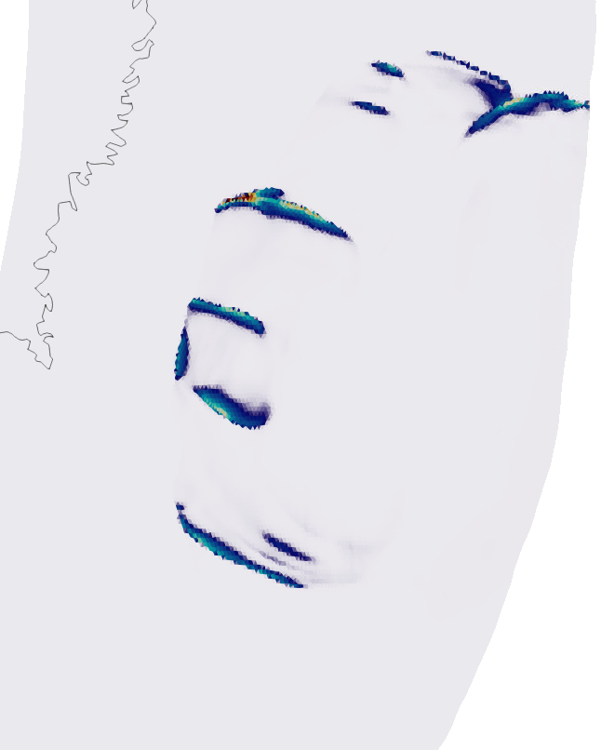
Combined Effects of Fast-Velocity Weakening Friction and Stress Heterogeneity Control Megathrust Earthquake Re-Activation, High-Frequency Radiation, and Arrest in 3D Dynamic Rupture Simulations of the 2011 Mw 9.0 Tohoku-Oki Earthquake
NMEM 2024
Jeremy Wing Ching Wong, Alice-Agnes Gabriel, Wenyuan Fan
8s
15s
25s
35s
50s
60s
Re-nucleation
Rupture front
Re-nucleation
Rupture front
Down-dip slip pulses
3D dynamic rupture simulation of the 2011 Tohoku-Oki earthquake rupture featuring spontaneous re-activation, high-frequency radiation, and arrest

Slide 2
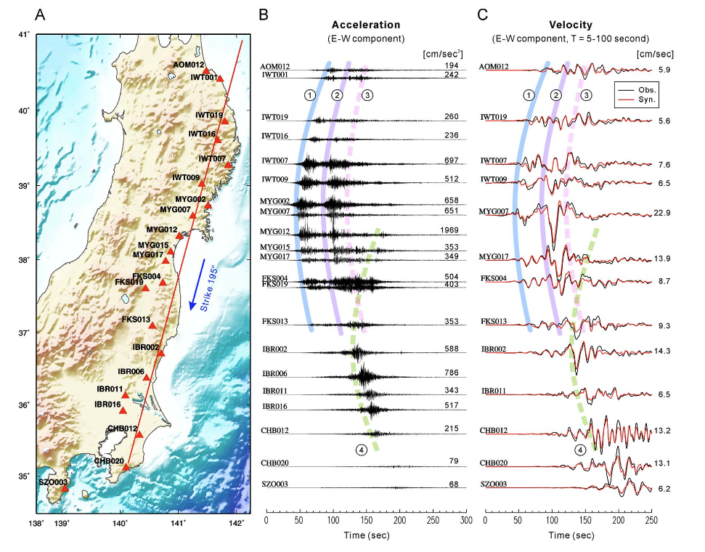
Rupture re-activation during the Tohoku-Oki earthquake
Strong ground motion recordings and finite-fault inversions suggest rupture re-activation at the hypocenter region of the Tohoku-Oki earthquake
First wavefront
Second wavefront
Lee et al., 2011
Strong-ground motions records
Finite-fault model using regional seismic data
Notes:
Just in case there are questions - there is a more faint 3rd pulse also visible in the data and finite fault model

Slide 3
Rupture re-activation during the Tohoku-Oki earthquake
Strong ground motion recordings and finite-fault inversions suggest rupture re-activation at the hypocenter region of the Tohoku-Oki earthquake
First wavefront
Second wavefront
Lee et al., 2011
Strong-ground motions records
Finite-fault model using regional seismic data
Notes:
The first rupture caused updip
While the second rupture caused on extension of the rupture both up dip and down-dip direction
Episodic rupture fronts at the end of the third rupture

Slide 4
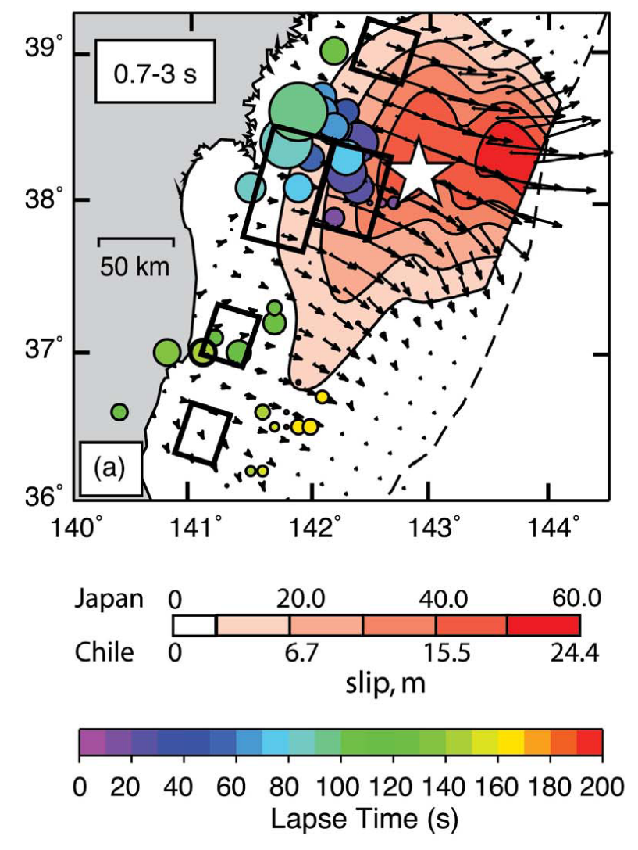
Down-dip high-frequency radiation
Teleseismic back-projection analysis suggest down-dip high-frequency radiation
Large fault displacements occurred at shallow depths
Lay et al., 2012
Notes:
teleseismic short-period radiation preferentially emanated from the deeper portion of the megathrusts whereas the largest fault displacements occurred at shallower depths but produced relatively little coherent short-period radiation

Slide 5
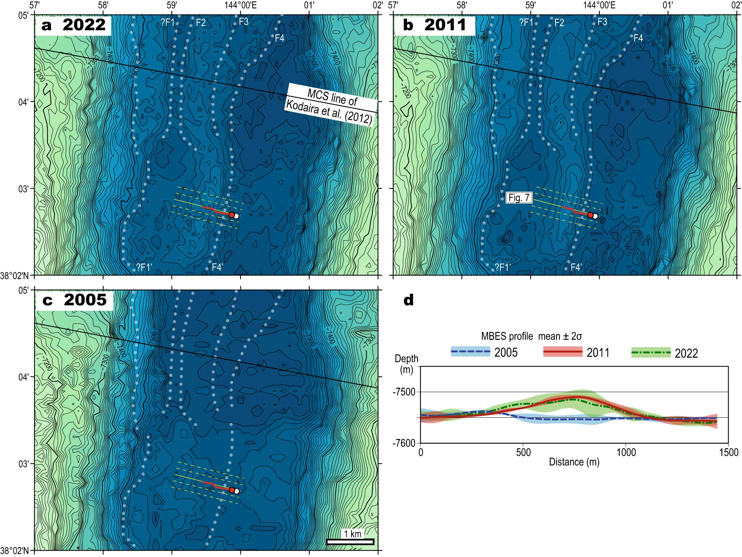
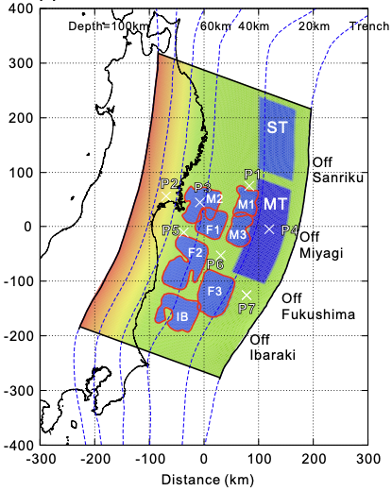
Along-strike rupture arrest and slip to the trench
Tohoku-Oki earthquake did not rupture the entire megathrust
Large slip towards the trench is observed
Near trench bathymetric changes before and after Tohoku-Oki earthquake
Ueda et al., 2023
Shibazaki et al., 2019

Slide 6
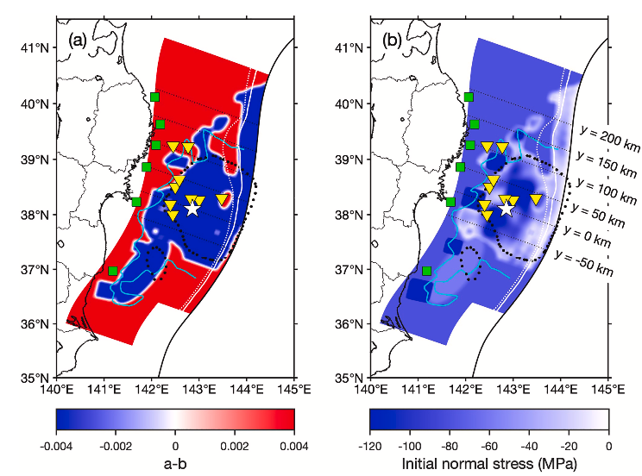
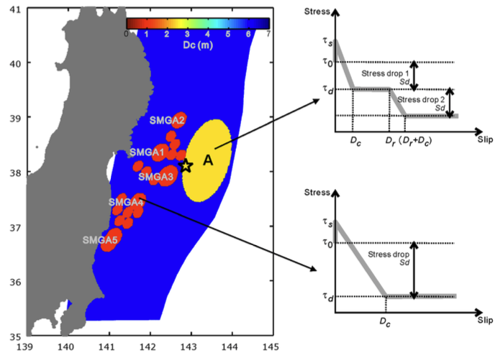
Friction or Stress - What governs megathrust earthquake complexity?
Stress asperities?
Frictional asperities and barriers?
Complex dynamic friction evolution?
We propose a self-consistent way to reproduce a realistic Tohoku-Oki earthquake rupture with the observed complexity
rupture re-activation
down-dip high frequency radiation
spontaneous rupture arrest
large slip towards the trench
Ma 2023
Galvez et al., 2020
Notes:
Stress asperites refers to area with large stress drop while frictional barriers refers to area with a large strength excess than their surroundings difference between 'barrier' and 'asperity' : large stress-drop regions (“asperities”) vs areas with a larger strength excess than their surroundings (“barriers”)

Slide 7
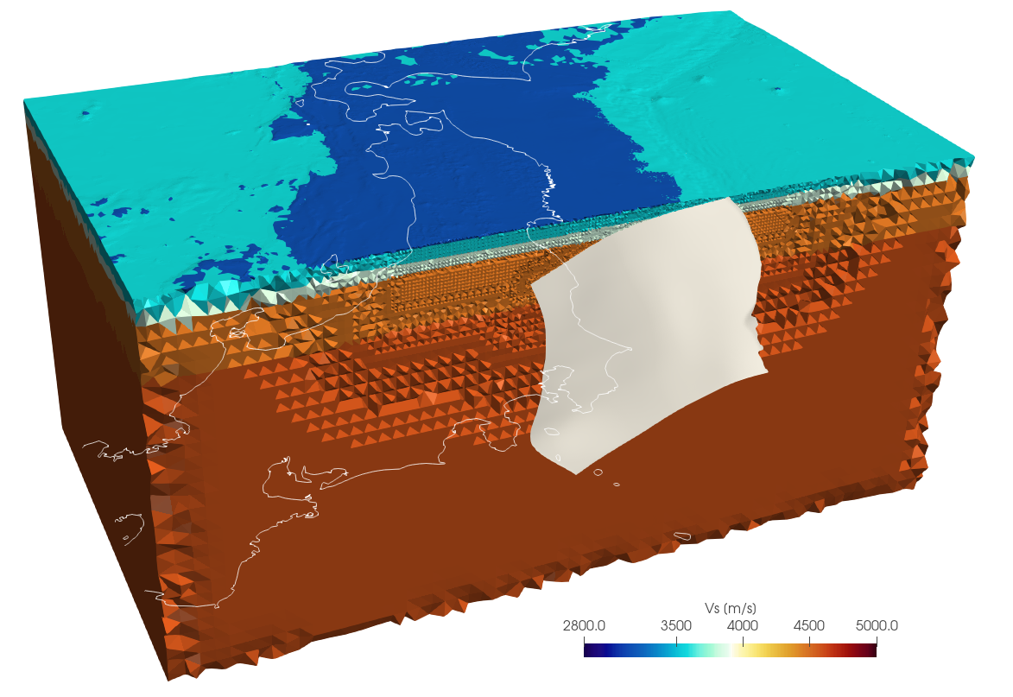
3D model with realistic slab geometry and topography
3D Topography and bathymetry (GEBCO)
Realistic slab geometry from Japan Integrated Velocity Structure Model (Koketsu, et al. 2012)
1D elastic layers Fukuyama (1998)
Depth dependent effective normal stress (overburden stress from 1D velocity layers + constant fluid pressure ratio γ = 0.9 )
Unstructured tetrahedral mesh (10,643,928 elements) Velocity aware meshing to resolve wave frequencies up to 0.5 Hz

Slide 8
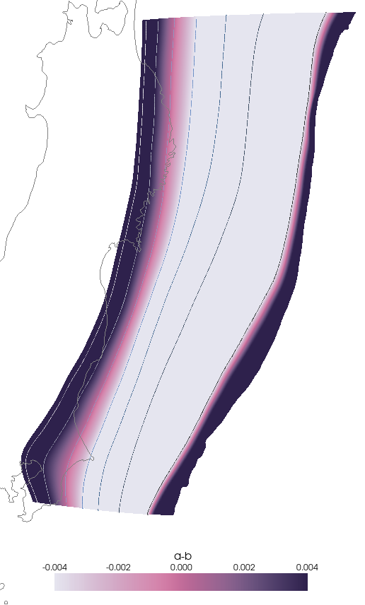
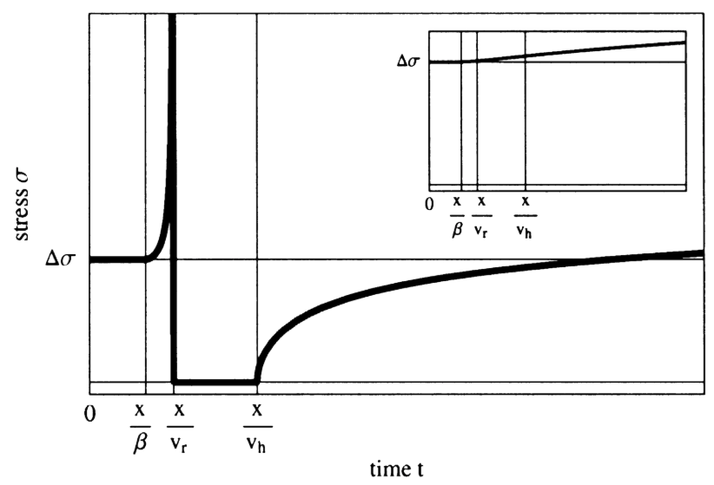
Fast velocity-weakening rate-and-state friction
Trench
Proxy to flash-heating that weakens friction at high slip-rate (Vw = 0.1 m/s)
Downdip limit (50km)
Tohoku-Oki earthquake rupture extent
Seismogenic zone
Updip limit (9km)
Updip limit (10km) from JIVSM model as boundary between accretionary wedge and crustal bedrock
Downdip limit (50km) from the seismicity of the Japan trench subduction zone (Nishikawa, et al., 2023)
Nielsen and Madariaga, 2003
Velocity weakening | Velocity strengthening

Slide 9
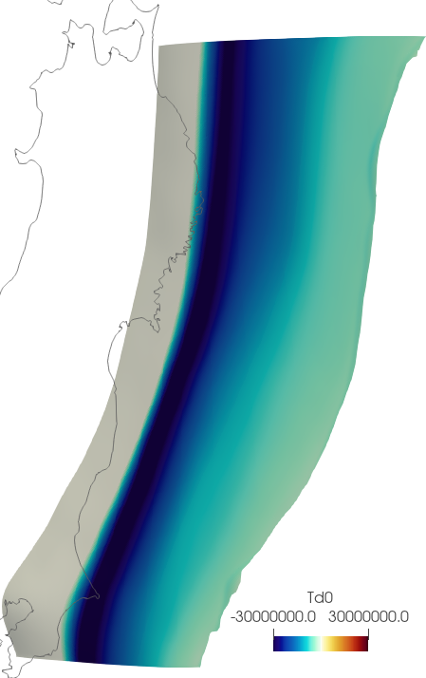
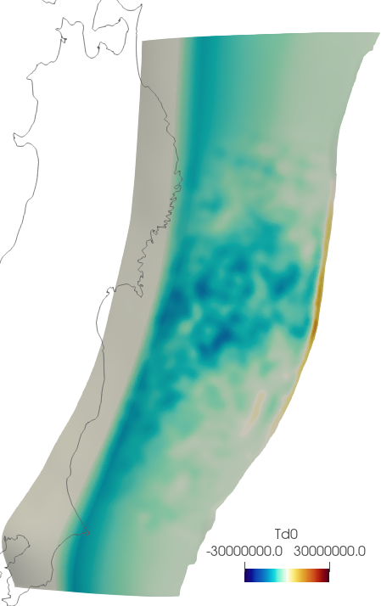
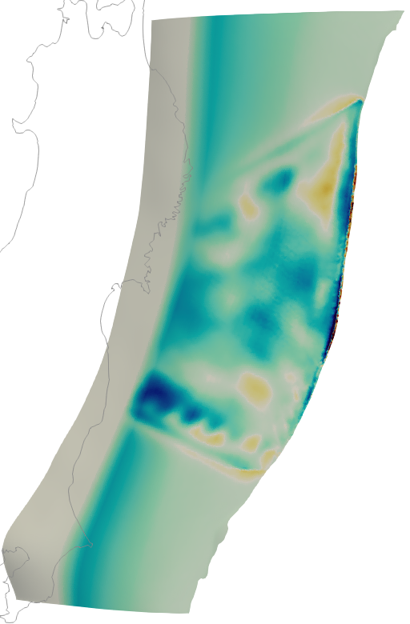
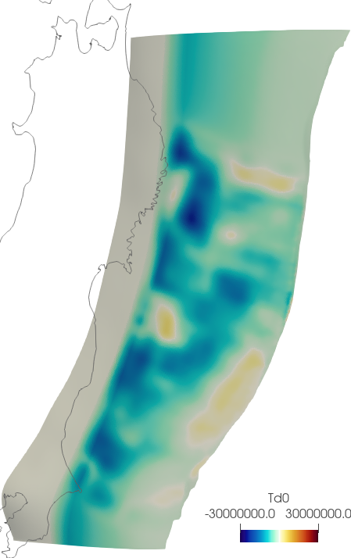
Stress heterogeneity
Regional stress model
(depth dependent, constrained from World Stress Map, Heidbach et al., 2016)
Finite-fault model informed multi-scale stress heterogeneity
Median slip model based on 32 existent inversions Wong et al., submitted
Kubota et al., 2023
Yagi et al., 2011
Along-dip traction [MPa]
-30 30

Slide 10
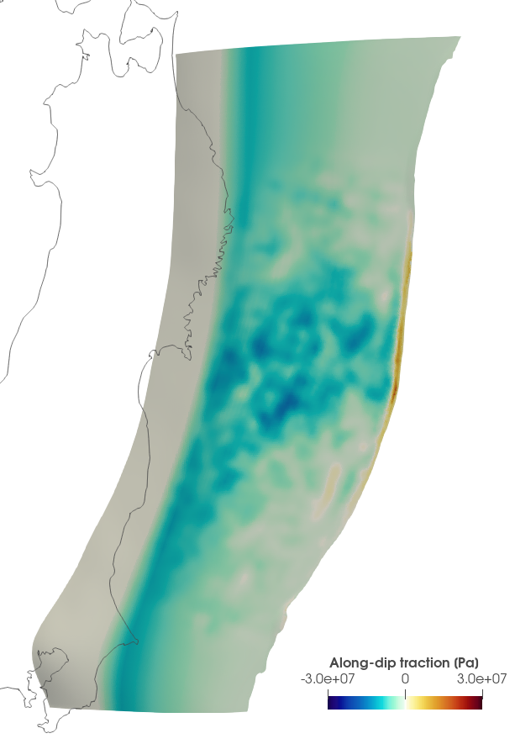
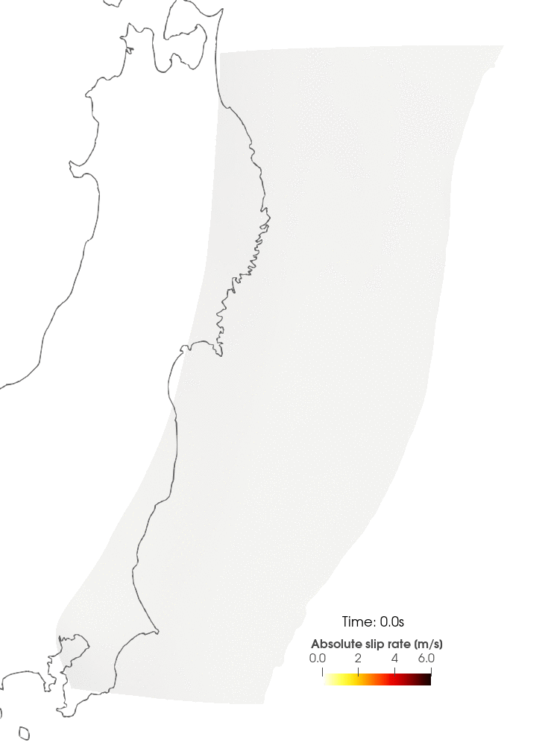
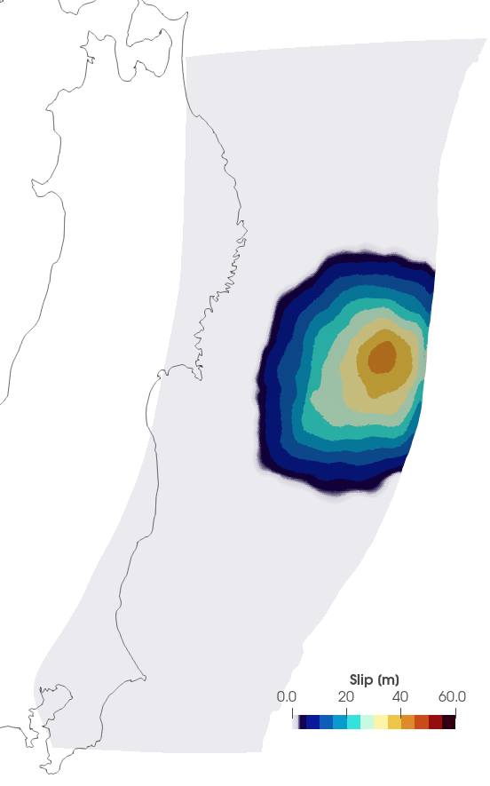
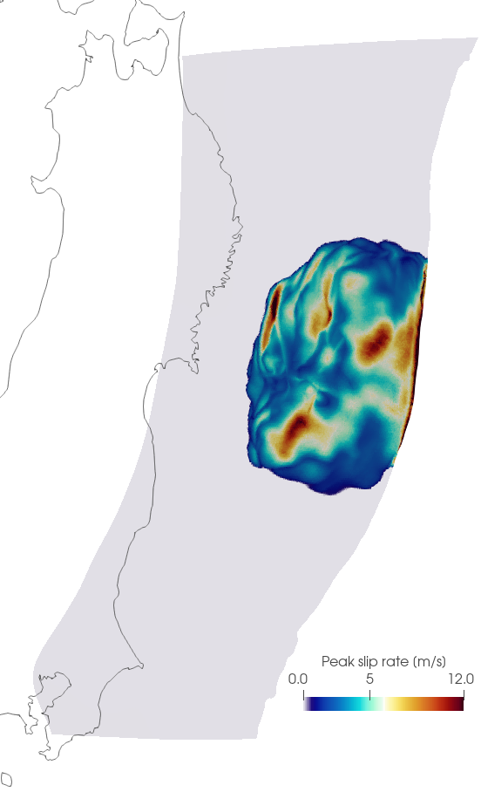
Complex rupture evolution and re-activation
Only stress heterogeneity is introduced into the simulation
Rupture re-activates in hypocenter region and generates down-dip slip pulses
median finite-fault model informed multi-scale stress heterogeneity
complex slip rate evolution with rupture reactivation and down-dip slip pulses
smooth final slip distribution
complex peak slip rate distribution
Rupture re-activation
Notes:
Mg1_RSs1_NUC_R1.5_S10_R001_sl1_t120s_OP09
Compare difference between Mg1_RS1_NUC

Slide 11
Complex rupture evolution and re-activation
Only stress heterogeneity is introduced into the simulation
Rupture re-activates in hypocenter region and generates down-dip slip pulses
median finite-fault model informed multi-scale stress heterogeneity
complex slip rate evolution with rupture reactivation and down-dip slip pulses
smooth final slip distribution
complex peak slip rate distribution
Rupture re-activation
Notes:
Mg1_RSs1_NUC_R1.5_S10_R001_sl1_t120s_OP09
Compare difference between Mg1_RS1_NUC

Slide 12
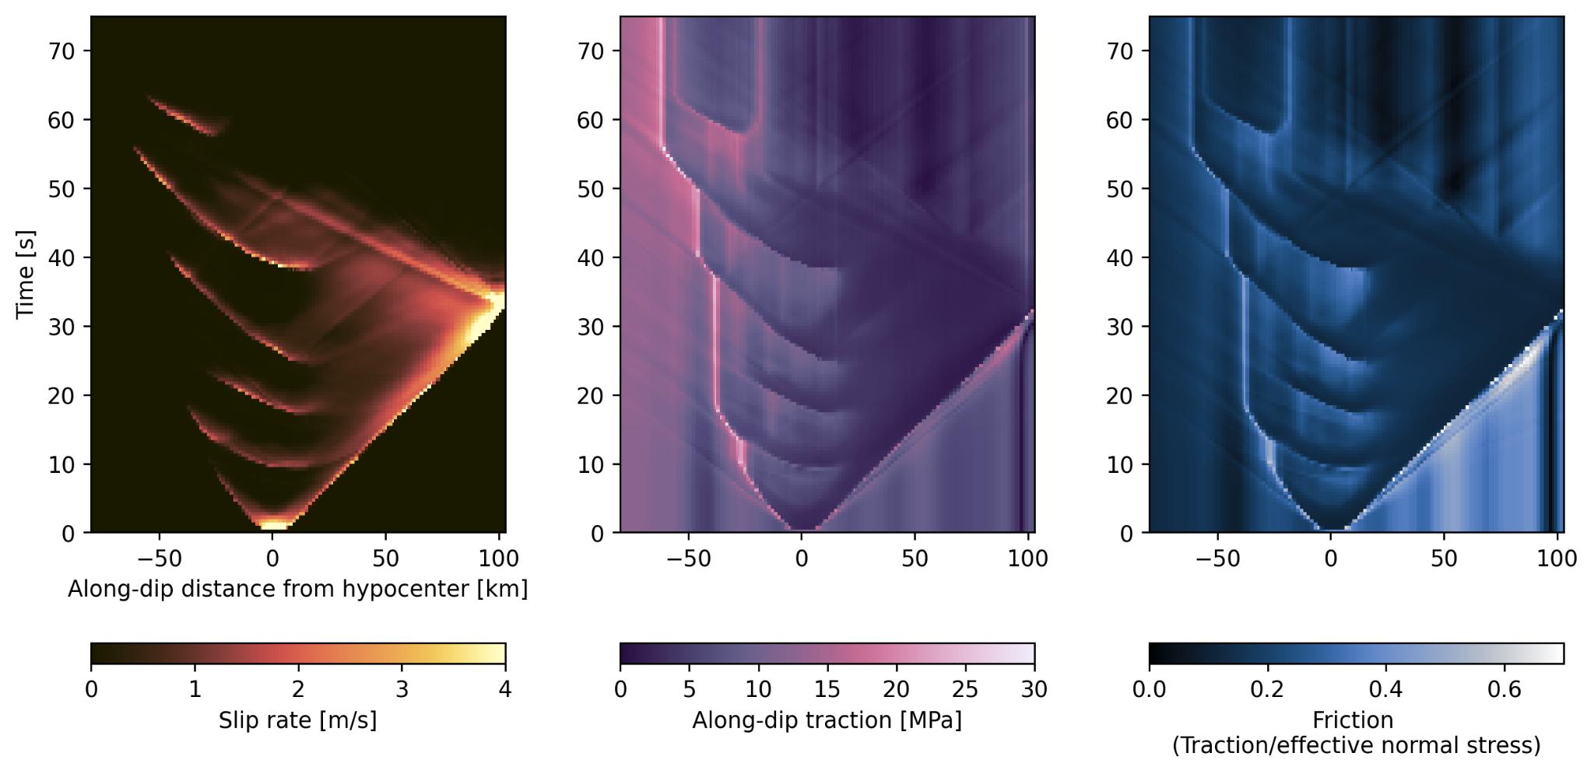
Episodic re-activation at the hypocenter due to strong frictional restrengthening
Strong coseismic restrengthening re-activates rupture in the hypocenter region
down-dip slip pulses
re-activation
Down-dip
Up-dip
Notes:
M_RSs1_NUC_Tn36_R1.2_S10_R001_sl0.5_t120s_OP09_srW0.1-fault.xdmf

Slide 13
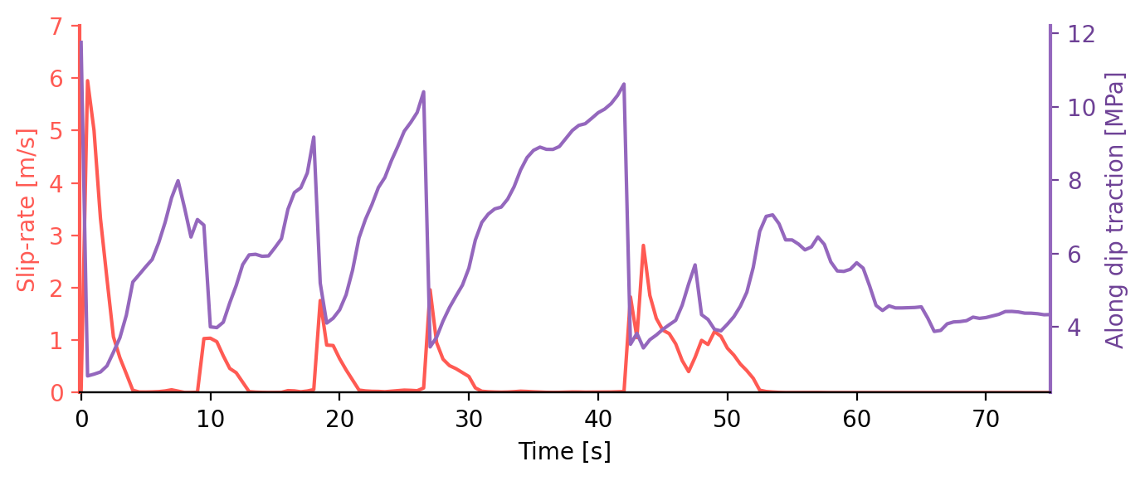
Episodic re-activation at the hypocenter due to strong frictional restrengthening
Strong coseismic restrengthening re-activates rupture in the hypocenter region
Along dip profile of slip-rate and traction
Hypocenter slip-rate and traction evolution
Coseismic restrengthening
Stress drop
Down-dip
Up-dip
Rupture episodes: 1 2 3 4 5
Notes:
M_RSs1_NUC_Tn36_R1.2_S10_R001_sl0.5_t120s_OP09_srW0.1-fault.xdmf
growing stress concentration left behind an initial self-similar slip pulse

Slide 14
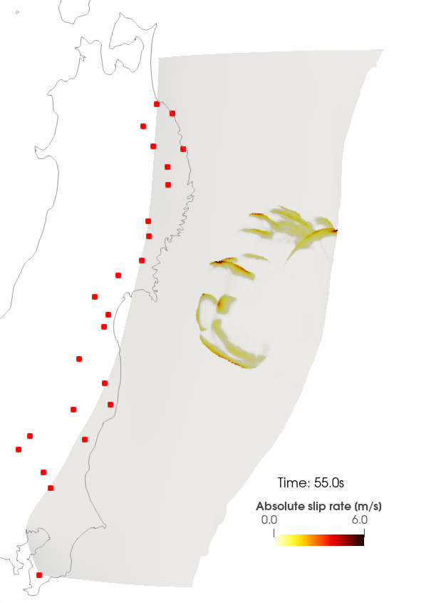
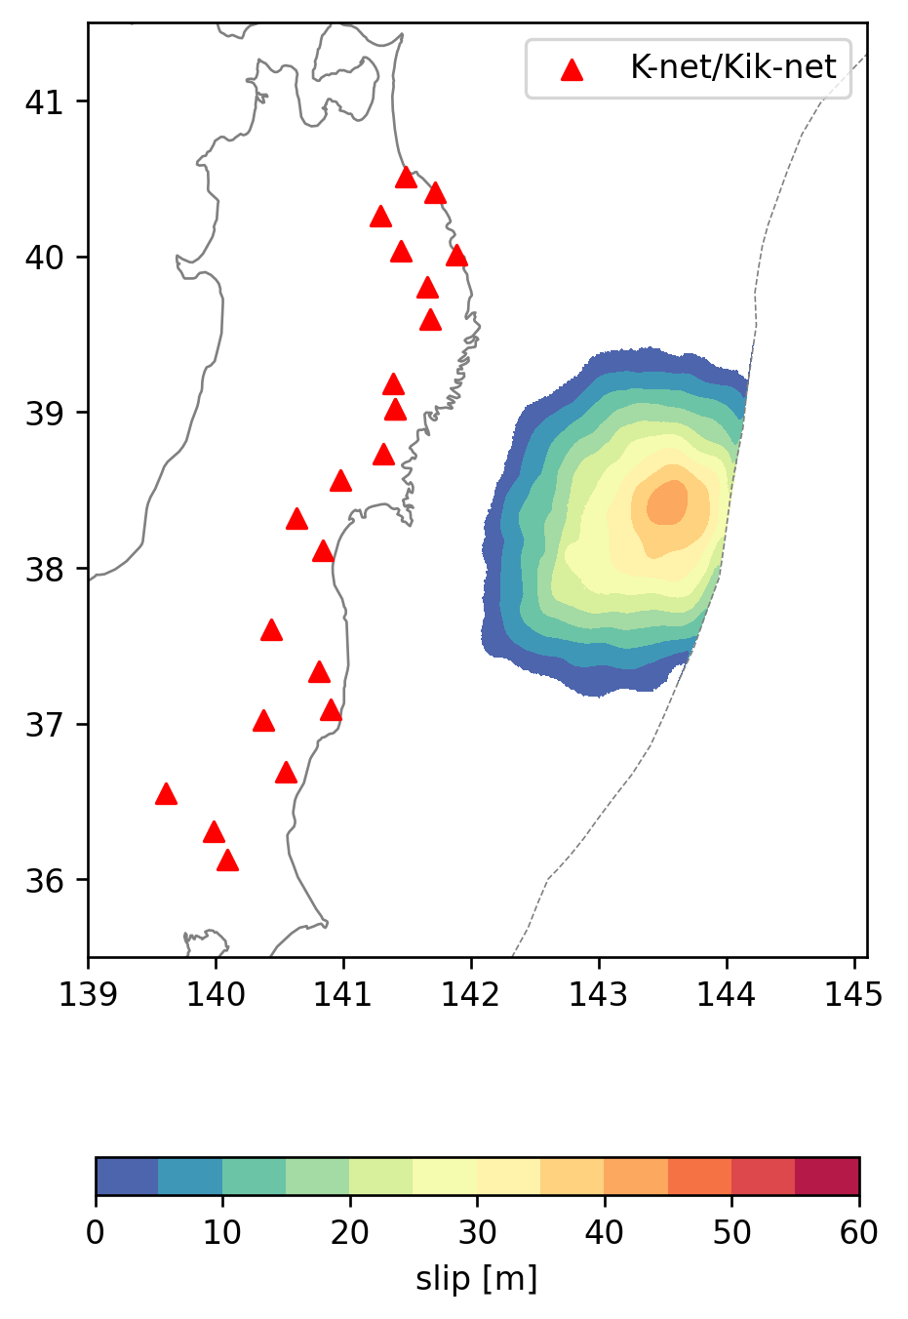
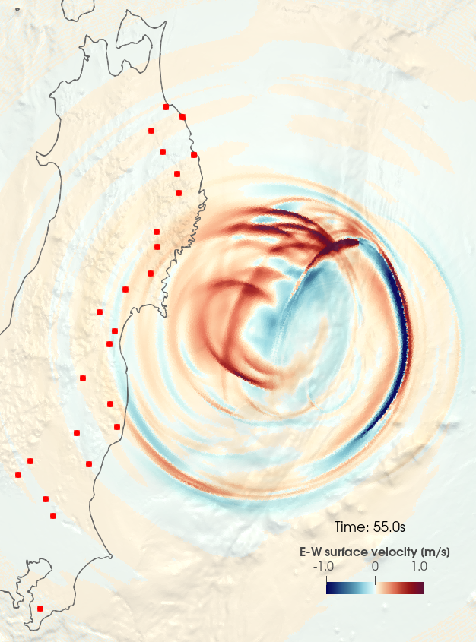
Synthetic waveforms on rupture reactivation
Final slip distribution
Slip rate
E-W component surface velocity

Slide 15
Synthetic waveforms on rupture reactivation
Final slip distribution

Slide 16
Does stress-heterogeneity play a role in rupture reactivation and down-dip slip pulses?
Regional stress model
(depth dependent, constrained from World Stress Map, Heidbach et al., 2016)
Finite-fault model informed stress heterogeneity
Along-dip traction [MPa]
Median slip model based on 32 existent inversions, Wong et al., submitted
-30 30

Slide 17
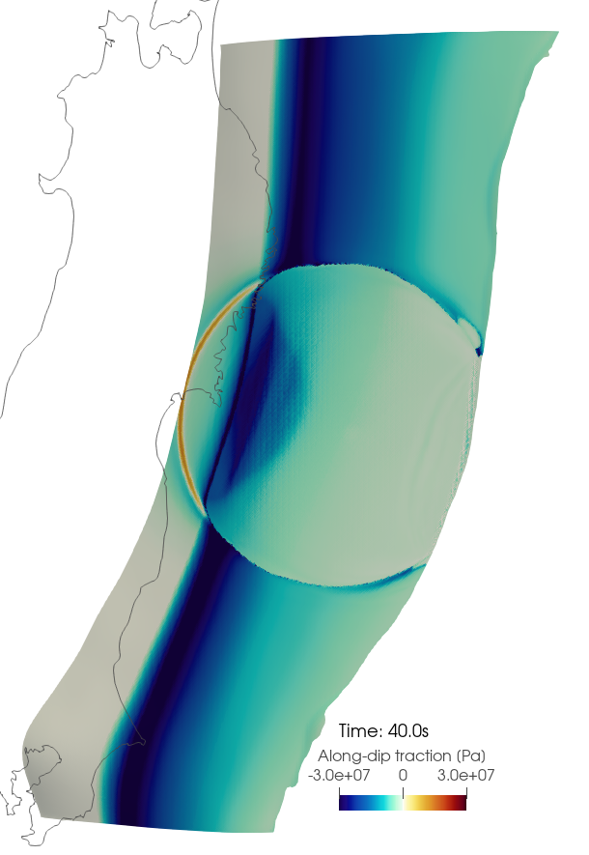
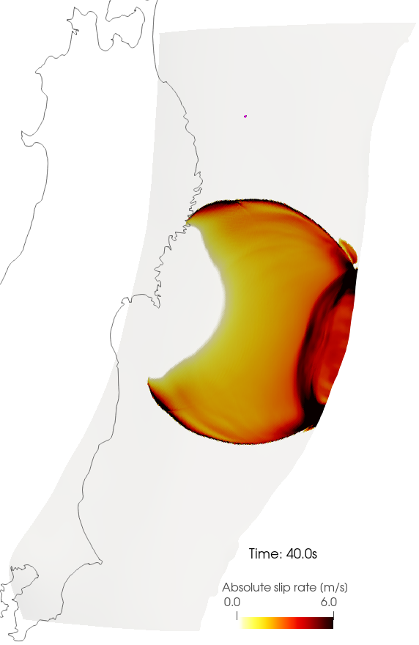
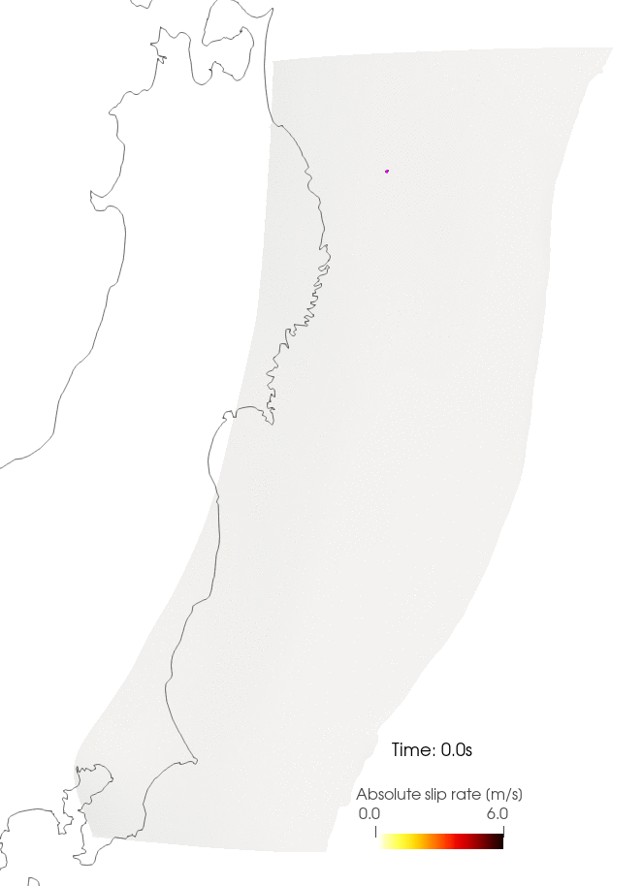
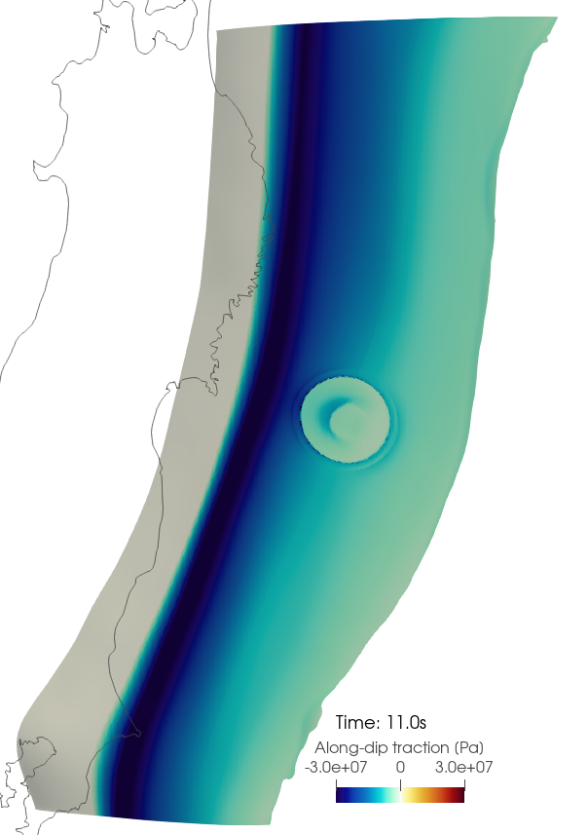
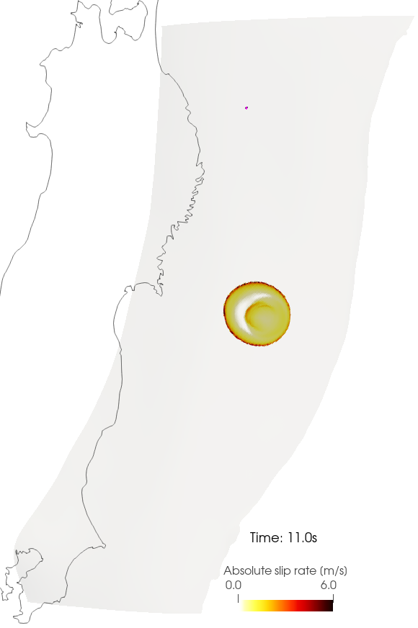
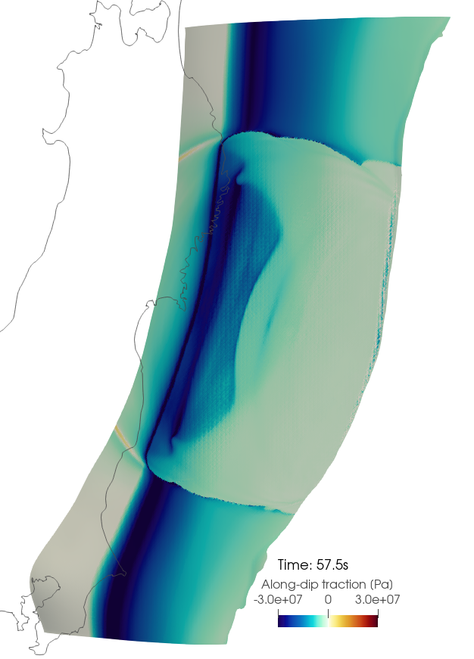
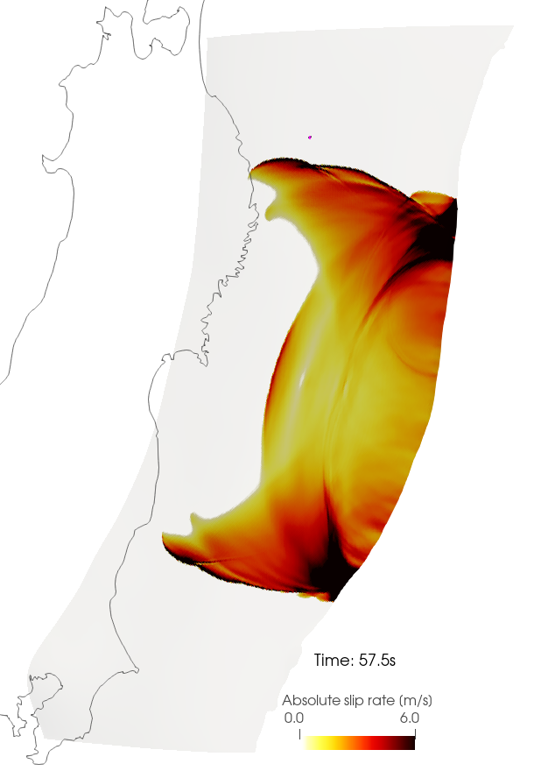
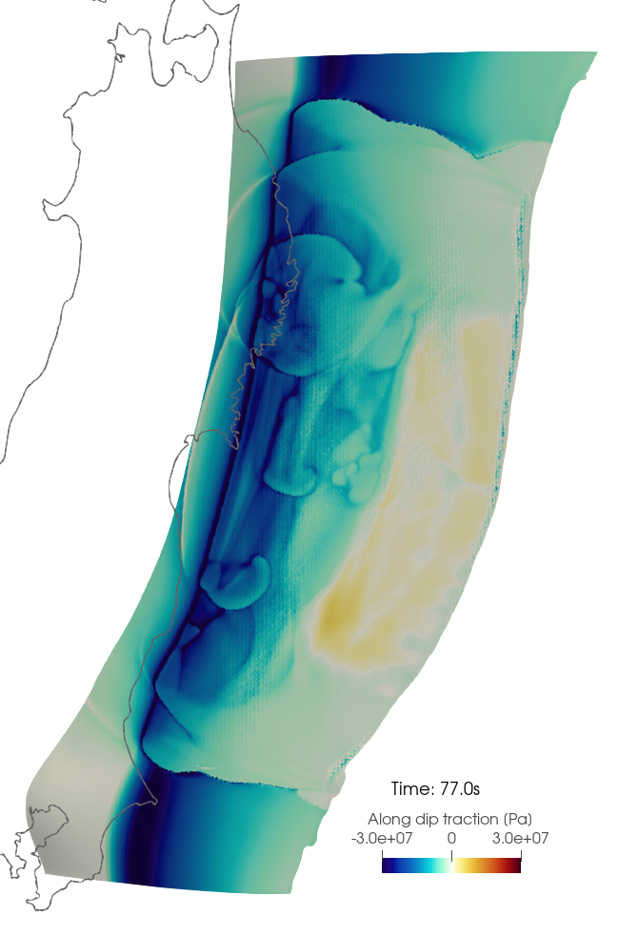
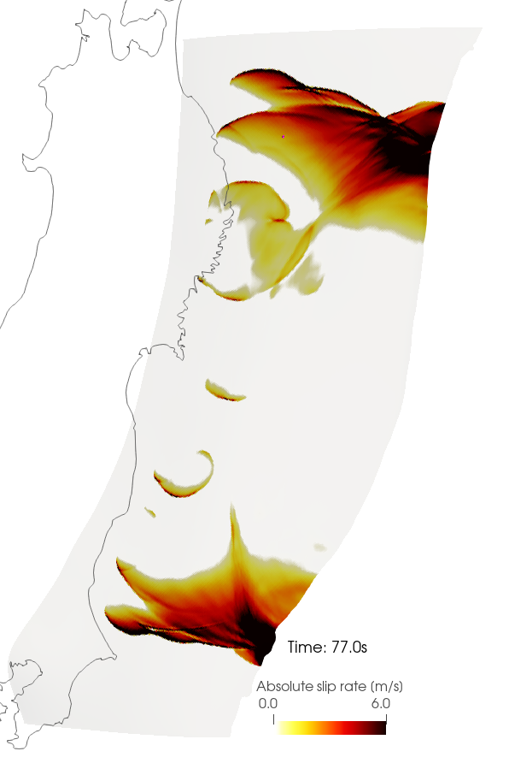
Regional-stress model - no stress heterogeneity
Strong coseismic restrengthening reactivates rupture in the hypocenter region and down-dip slip pulses
Along-dip traction Slip-rate
t = 11s re-nucleate at the hypocenter
t = 40s rupture limited at downdip and free-surface reflection
t = 57s secondary downdip rupture front
t = 77s delayed pulses at downdip region

Slide 18
Regional-stress model - no stress heterogeneity
Strong coseismic restrengthening reactivates rupture in the hypocenter region and down-dip slip pulses
Along-dip traction Slip-rate
t = 11s re-nucleate at the hypocenter
t = 40s rupture limited at downdip and free-surface reflection
t = 57s secondary downdip rupture front
t = 77s delayed pulses at downdip region

Slide 19
Regional-stress model - no stress heterogeneity
Strong coseismic restrengthening reactivates rupture in the hypocenter region and down-dip slip pulses
Along-dip traction Slip-rate
t = 11s re-nucleate at the hypocenter
t = 40s rupture limited at downdip and free-surface reflection
t = 57s secondary downdip rupture front
t = 77s delayed pulses at downdip region

Slide 20
Regional-stress model - no stress heterogeneity
Strong coseismic restrengthening reactivates rupture in the hypocenter region and down-dip slip pulses
Along-dip traction Slip-rate
t = 11s re-nucleate at the hypocenter
t = 40s rupture limited at downdip and free-surface reflection
t = 57s secondary downdip rupture front
t = 77s delayed pulses at downdip region
Notes:
Early healing generated by barrier? Hence leading the coseismic restrengthening at down dip region, leading to the slip pulses at depth

Slide 21
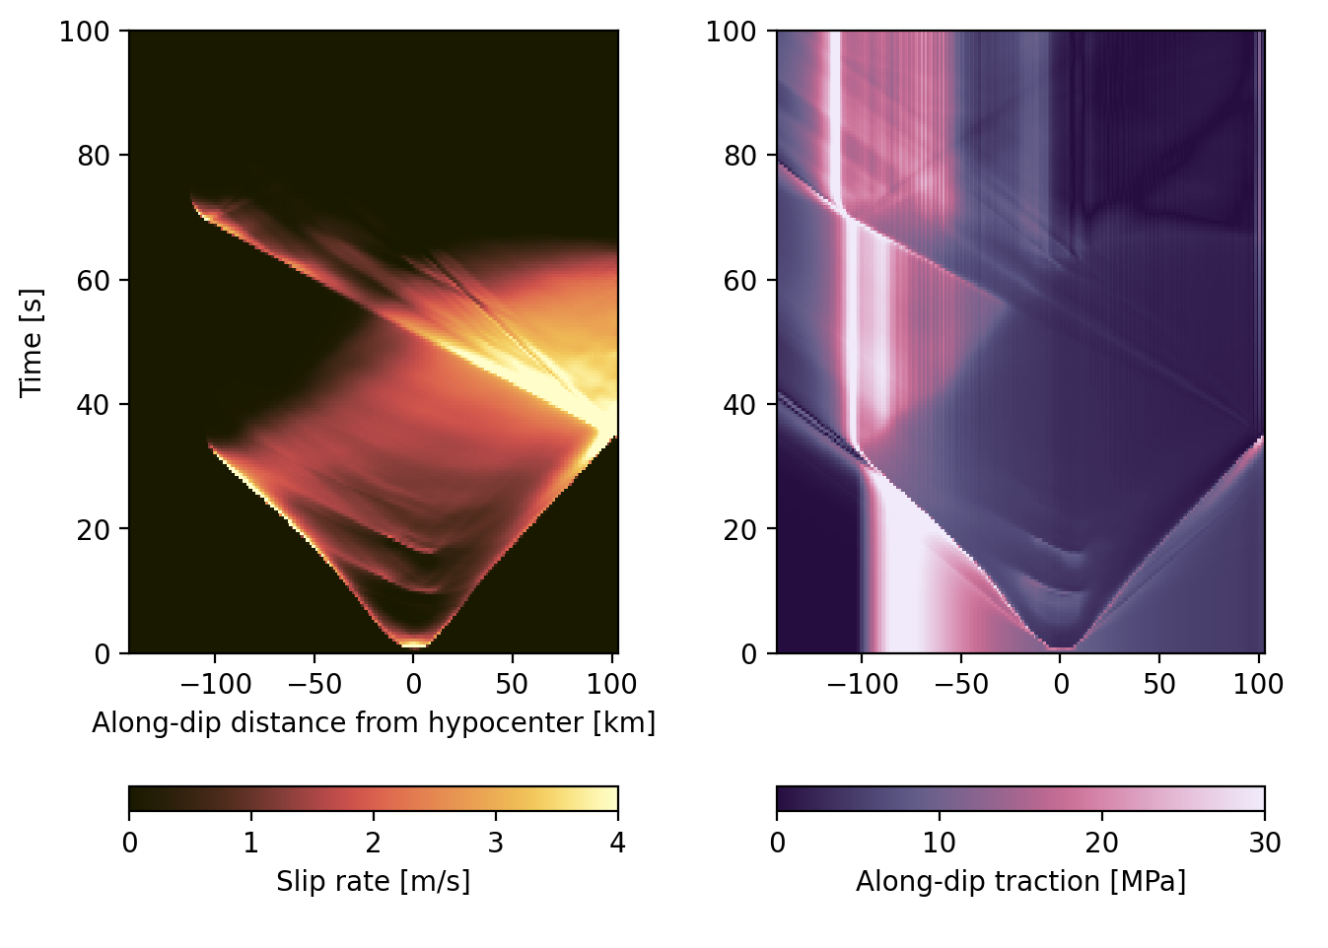
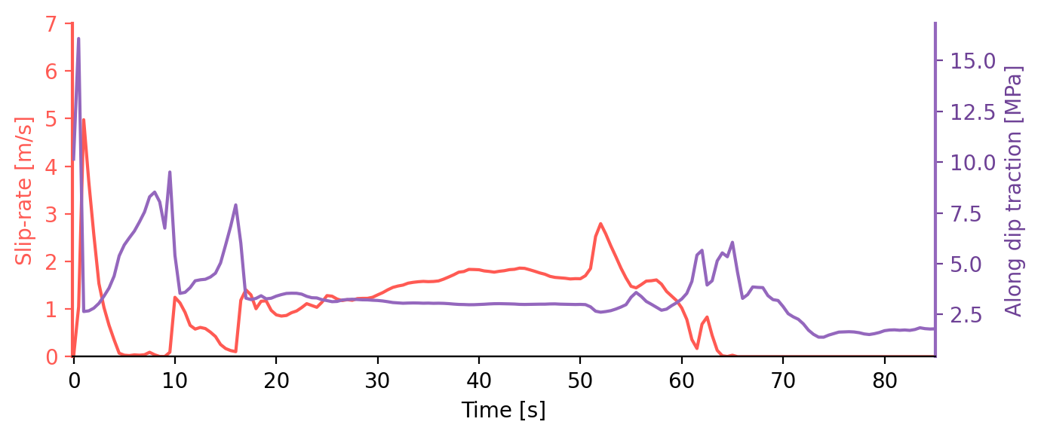
Does stress-heterogeneity play a role in rupture reactivation?
Stress heterogeneity is not required for rupture reactivation and down-dip pulses
Strong coseismic re-strengthening leads to rupture reactivation and down-dip pulses
Along dip profile of slip-rate and traction
Hypocenter slip-rate and traction evolution
Coseismic restrengthening
stress drop
Notes:
RegStr06_RSs1_NUC_R1.2_S05_sl0.8_t200s-fault.xdmf

Slide 22
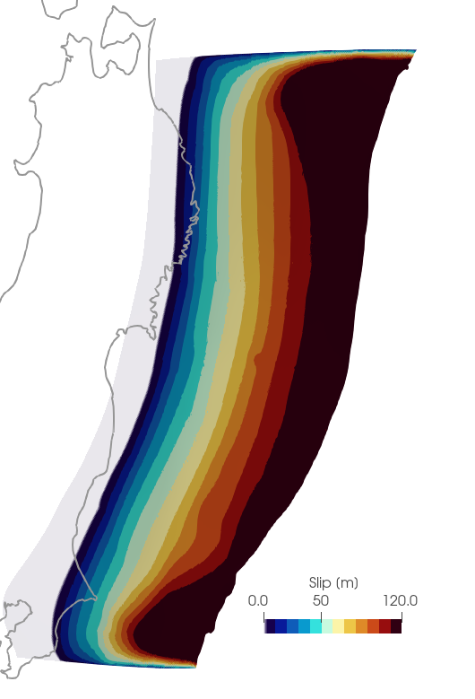
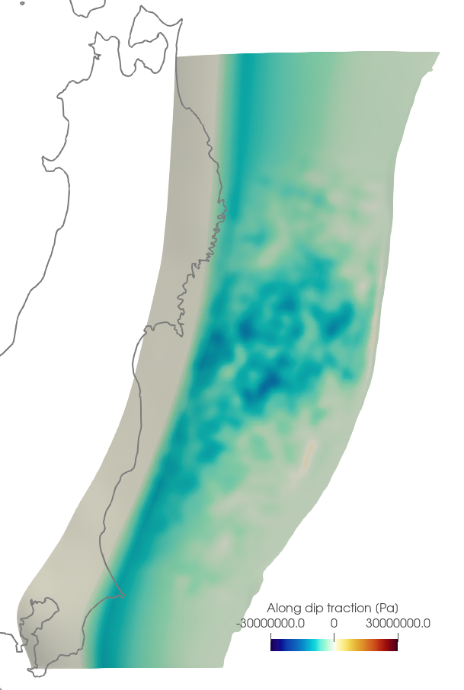
Spontaneous rupture arrest due to stress heterogeneity
Spontaneous rupture arrest along-strike due to stress heterogeneity
Regional initial stress (depth-dependent)
Resulting slip distribution
Median finite-fault model informed multi-scale stress heterogeneity
Resulting slip distribution
Along-dip traction [MPa]
Along-dip traction [MPa]
Slip [m]
-30 30
-30MPa 30 MPa
Notes:
Mg1_RSs1_NUC_R1.5_S10_R001_sl1_t120s_OP09
Compare difference between Mg1_RS1_NUC

Slide 23
Spontaneous rupture arrest due to stress heterogeneity
Spontaneous rupture arrest along-strike due to stress heterogeneity
Regional initial stress (depth-dependent)
Resulting slip distribution
Median finite-fault model informed multi-scale stress heterogeneity
Resulting slip distribution
Median of 32 kinematic slip model
Along-dip traction [MPa]
Along-dip traction [MPa]
Slip [m]
-30 30
-30MPa 30 MPa
Notes:
Mg1_RSs1_NUC_R1.5_S10_R001_sl1_t120s_OP09
Compare difference between Mg1_RS1_NUC

Slide 24
Conclusions - What governs the 3D complexity of the Tohoku-Oki earthquake?
Coseismic re-strengthening controls rupture reactivation and down-dip slip pulses
Stress heterogeneity is not required for rupture reactivation or down-dip slip pulses
Stress heterogeneity informed by finite-fault models is sufficient to spontaneously arrest earthquake rupture along-strike

