Slide 1




Effects of Bimaterial Interface on Rupture along Branch Faults
Evan Marschall¹ , Roby Douilly¹ & Nobuki Kame²
¹Dept. of Earth and Planetary Sciences, University of California: Riverside, ² Earth Research Institute, University of Tokyo.

Slide 2
Geometric complexities on fault systems
Importance: complex regions along a fault may influence rupture behavior; could conditionally terminate, redirect or allow continuation of rupture.

Slide 3
Geometric complexities on fault systems
Importance: complex regions along a fault may influence rupture behavior; could conditionally terminate, redirect or allow continuation of rupture.
Some common examples

Slide 4
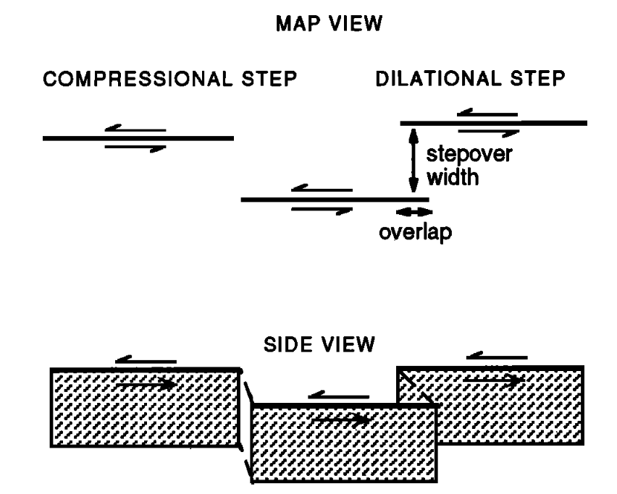
Geometric complexities on fault systems
Importance: complex regions along a fault may influence rupture behavior; could conditionally terminate, redirect or allow continuation of rupture.
Some common examples
Fault stepovers
Harris & Day, 1993

Slide 5
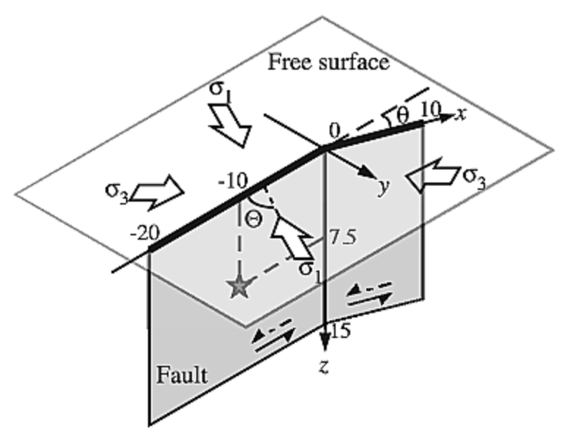
Geometric complexities on fault systems
Importance: complex regions along a fault may influence rupture behavior; could conditionally terminate, redirect or allow continuation of rupture.
Some common examples
Fault stepovers
Fault bends
Harris & Day, 1993
King & Nábělek, 1985;
Kase & Day, 2006

Slide 6
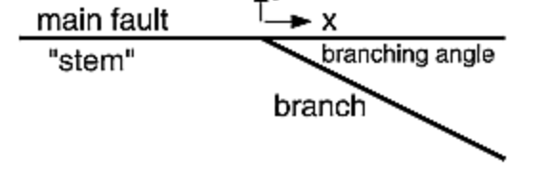
Geometric complexities on fault systems
Importance: complex regions along a fault may influence rupture behavior; could conditionally terminate, redirect or allow continuation of rupture.
Some common examples
Fault stepovers
Fault bends
Branch faults
Aochi et al, 2000;
Kame et al., 2003;
Duan & Oglesby, 2007
Harris & Day, 1993
King & Nábělek, 1985;
Kase & Day, 2006

Slide 7
Earthquakes on Branch Faults
Earthquakes on branch fault systems have demonstrated a variety of behaviors.

Slide 8
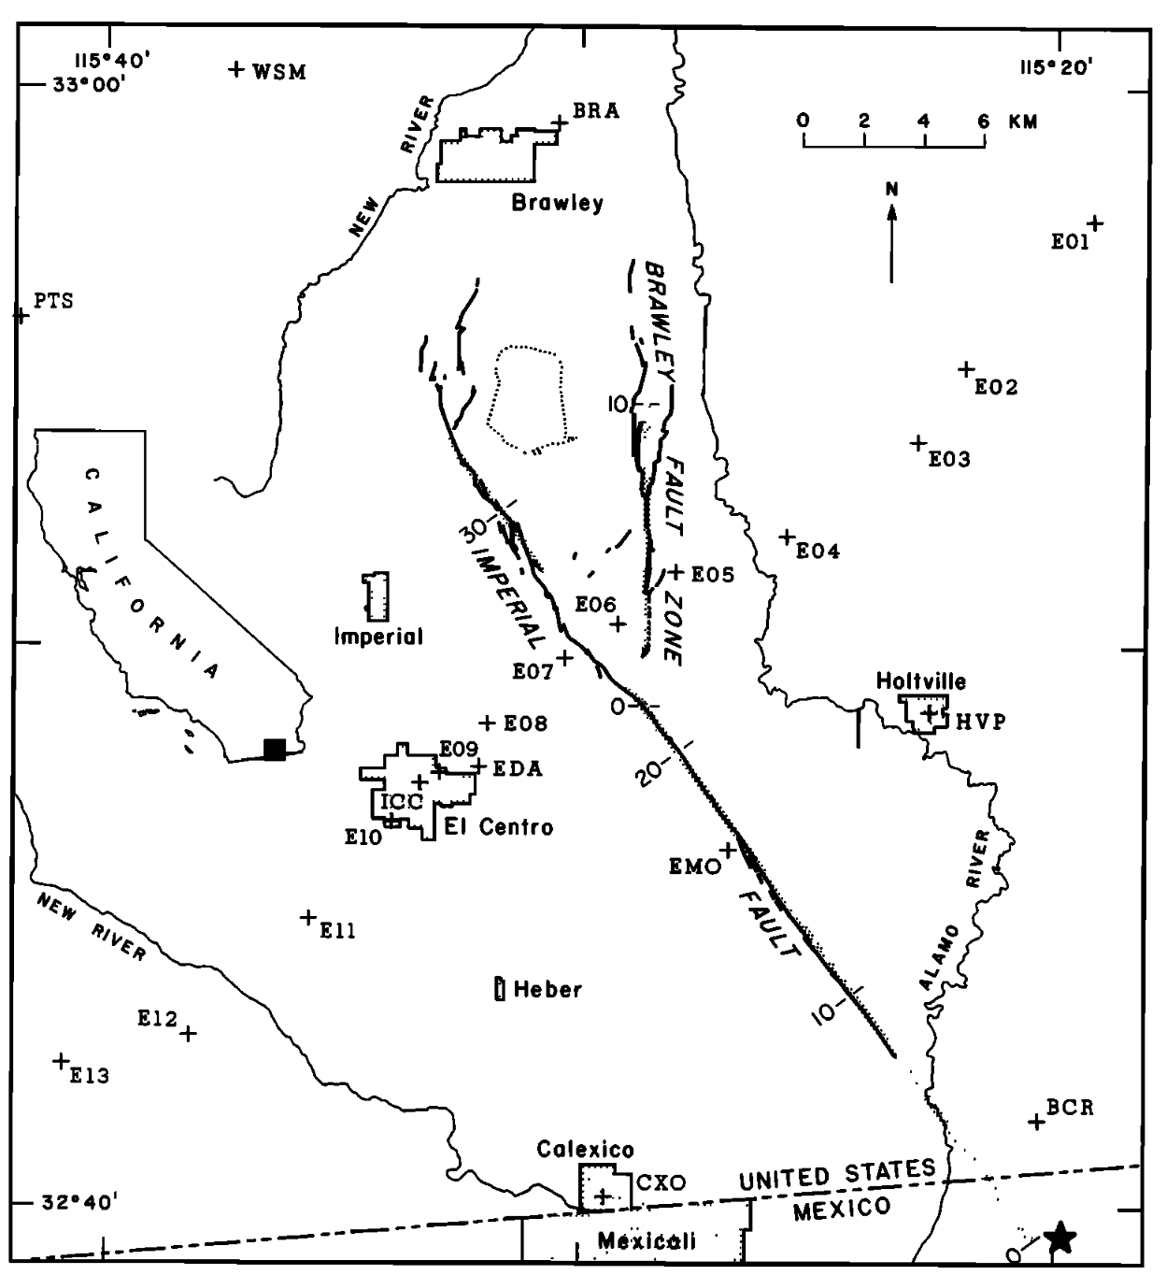
Earthquakes on Branch Faults
Earthquakes on branch fault systems have demonstrated a variety of behaviors.
1: Rupture on both the main and secondary fault
1979 Imperial Valley
Archuleta, 1984

Slide 9
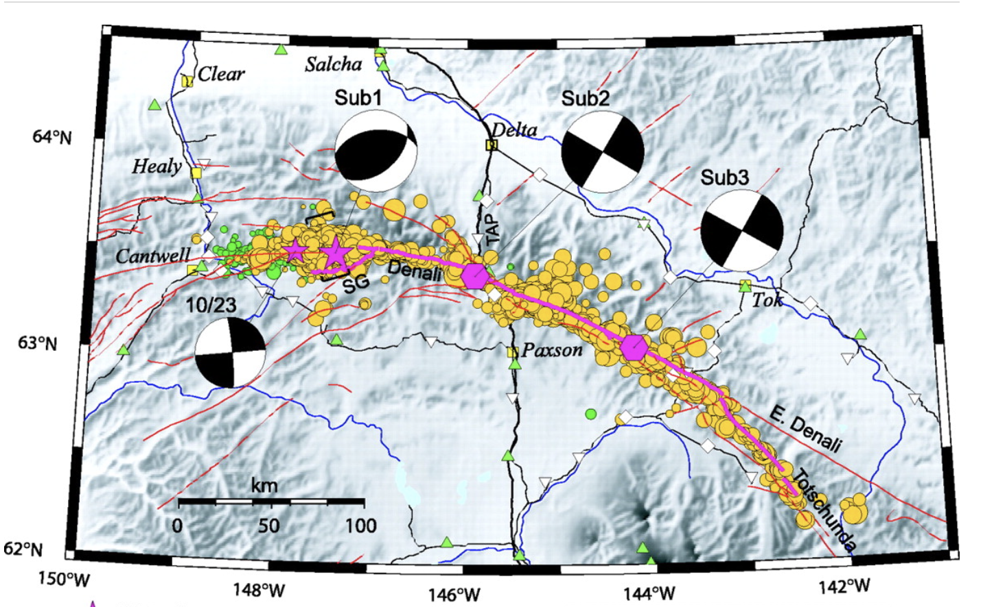
Earthquakes on Branch Faults
Earthquakes on branch fault systems have demonstrated a variety of behaviors.
1: Rupture on both the main and secondary fault
2. Rupture transfers to the secondary segment
1979 Imperial Valley
2002 Denali
Archuleta, 1984
Eberhart-Phillips et al., 2003

Slide 10
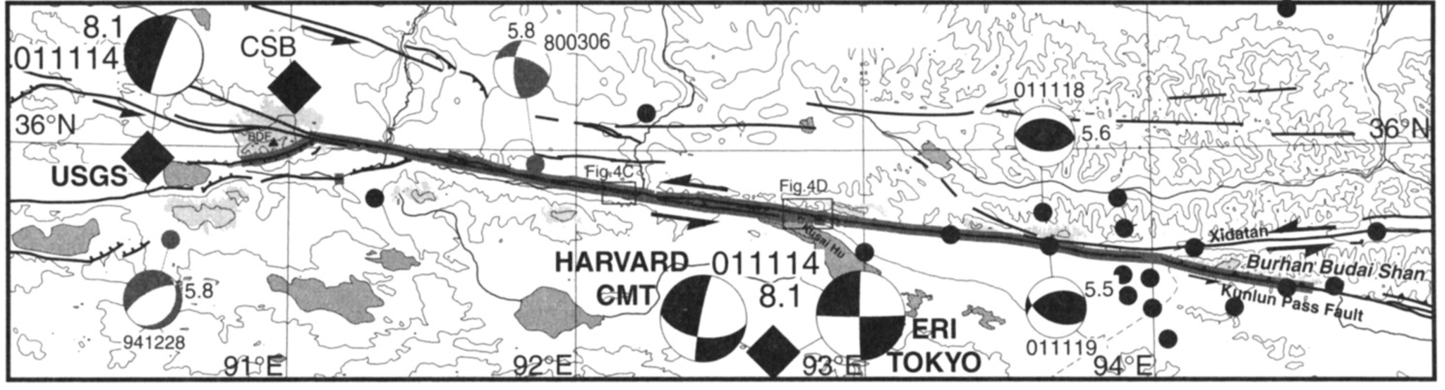
Earthquakes on Branch Faults
Earthquakes on branch fault systems have demonstrated a variety of behaviors.
1: Rupture on both the main and secondary fault
2. Rupture transfers to the secondary segment
3. Rupture remains solely on the main fault
1979 Imperial Valley
2002 Denali
2001 Kokoxili
Van der Woerd et al., 2002
Archuleta, 1984
Eberhart-Phillips et al., 2003

Slide 11
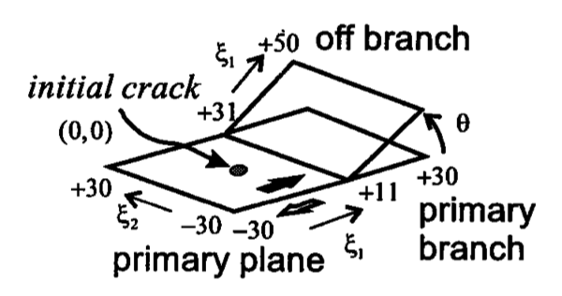
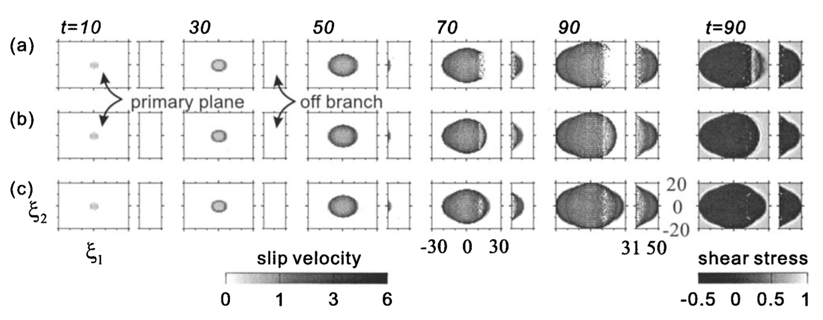
Which Factors Influence Rupture Behavior
Branch Angle
Aochi et al, 2000

Slide 12
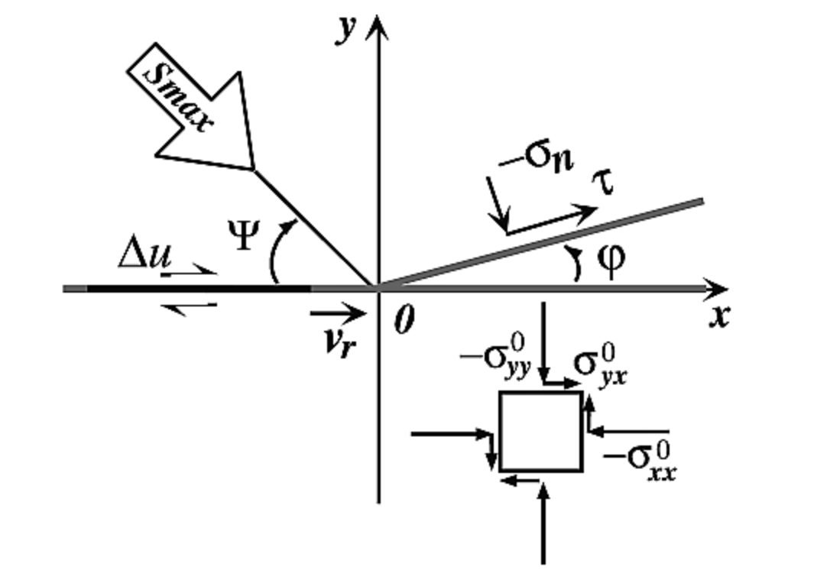
Which Factors Influence Rupture Behavior
Branch Angle
Pre-Stress
Kame et al., 2003; Bhat et al., 2007
Aochi et al, 2000

Slide 13
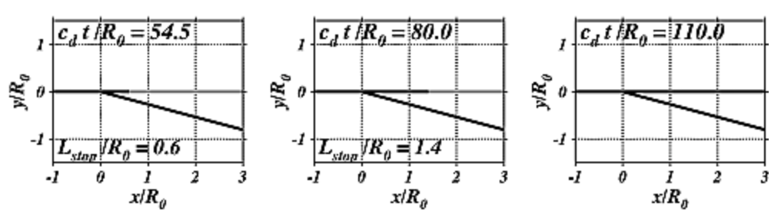
Which Factors Influence Rupture Behavior
Branch Angle
Pre-Stress
Rupture Speed
Kame et al., 2003; Bhat et al., 2007
Kame et al., 2003; Bhat et al., 2007
Aochi et al, 2000

Slide 14
What about material properties?
Several branch fault systems separate dissimilar media.

Slide 15
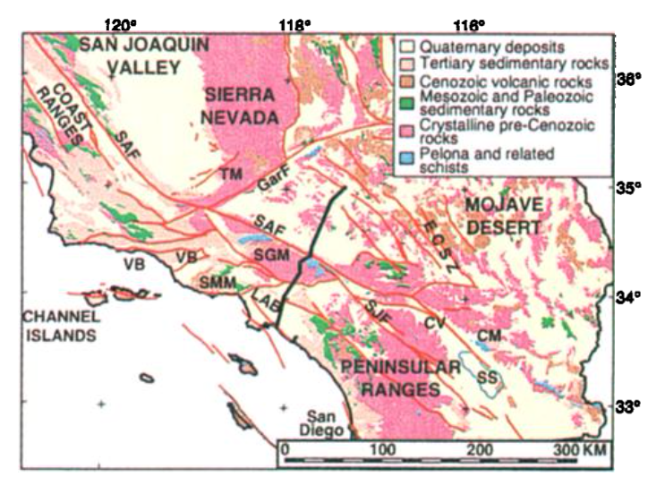
What about material properties?
Several branch fault systems separate dissimilar media.
San Andreas & Garlock
Langenheim & Hauksson, 2001

Slide 16
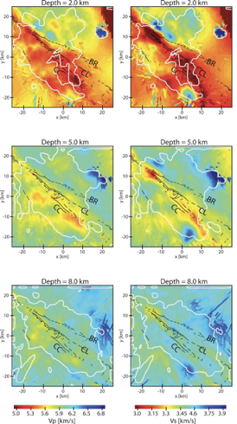
What about material properties?
Several branch fault systems separate dissimilar media *(In Southern California)
San Andreas & Garlock
Southern San Jacinto
Langenheim & Hauksson, 2001
Allam et al., 2014

Slide 17
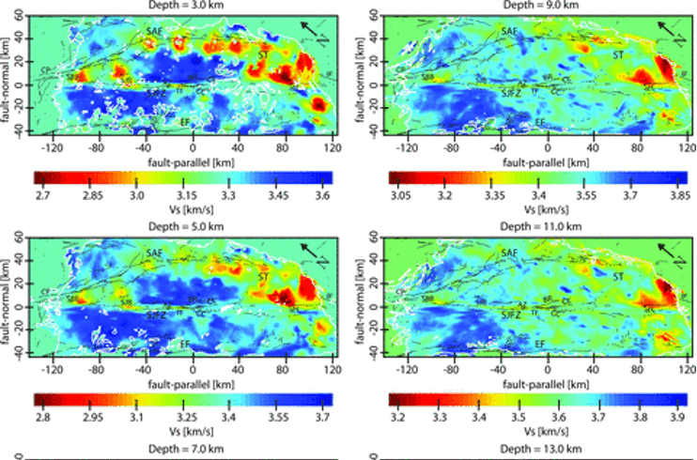
What about material properties?
Several branch fault systems separate dissimilar media *(In Southern California)
San Andreas & Garlock
Southern San Jacinto
Southern San Andreas
Langenheim & Hauksson, 2001
Allam & Ben-Zionn, 2012
Allam et al., 2014

Slide 18
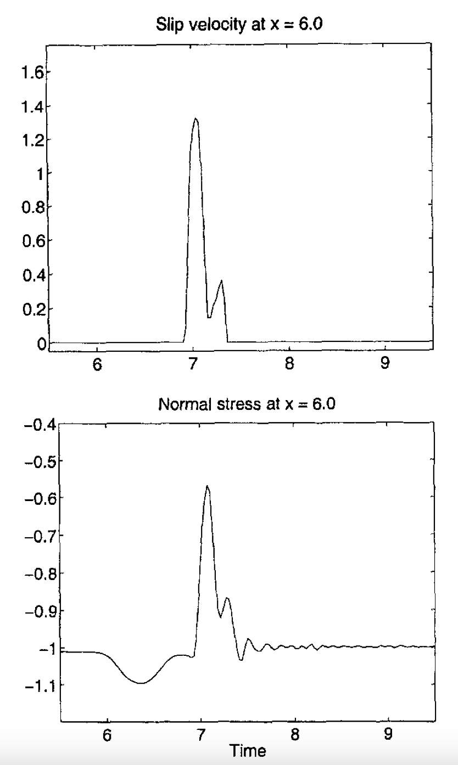
Why might this be important?
Material contrasts have been shown to induce normal stress perturbations on single fault systems. These may lead to a preferred rupture direction.
Theorized in 1980 by J. Weertman
Andrews & Ben-Zion, 1998

Slide 19
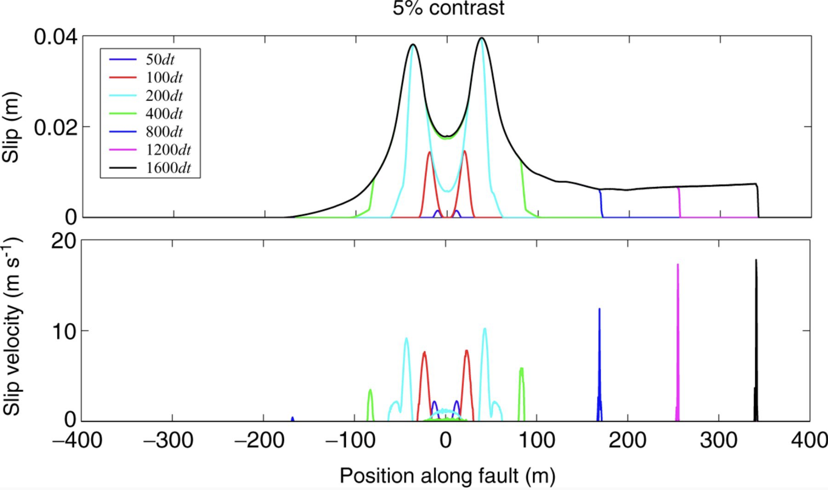
Why might this be important?
Material contrasts have been shown to induce normal stress perturbations on single fault systems. These may lead to a preferred rupture direction.
Rupture dies in one direction
Shi & Ben-Zion, 2006

Slide 20
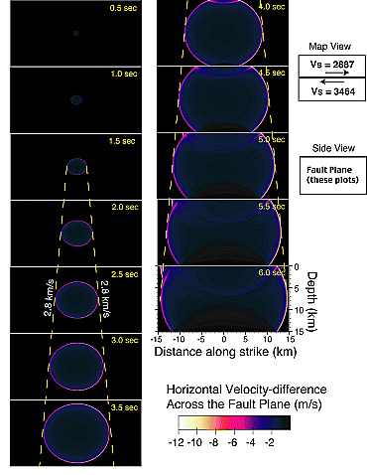
Why might this be important?
Material contrasts have been shown to induce normal stress perturbations on single fault systems. These may lead to a preferred rupture direction.
Rupture is symmetrical
Rupture dies in one direction
Shi & Ben-Zion, 2006
Harris & Day, 2005

Slide 21
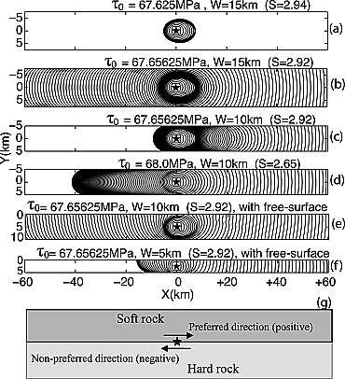
Why might this be important?
Material contrasts have been shown to induce normal stress perturbations on single fault systems. These may lead to a preferred rupture direction.
Rupture is symmetrical
Dependence on fault dimension
Rupture dies in one direction
Shi & Ben-Zion, 2006
Harris & Day, 2005
Dalguer & Day, 2009

Slide 22
So could this influence rupture on branch fault systems?

Slide 23
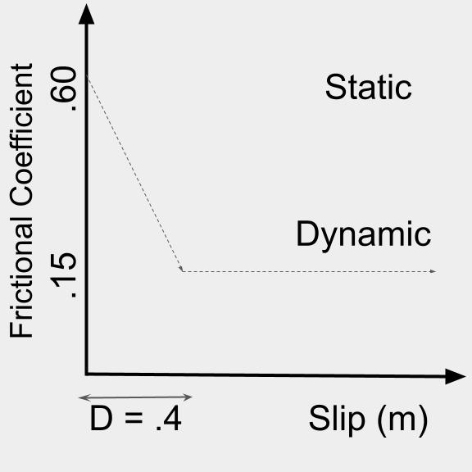
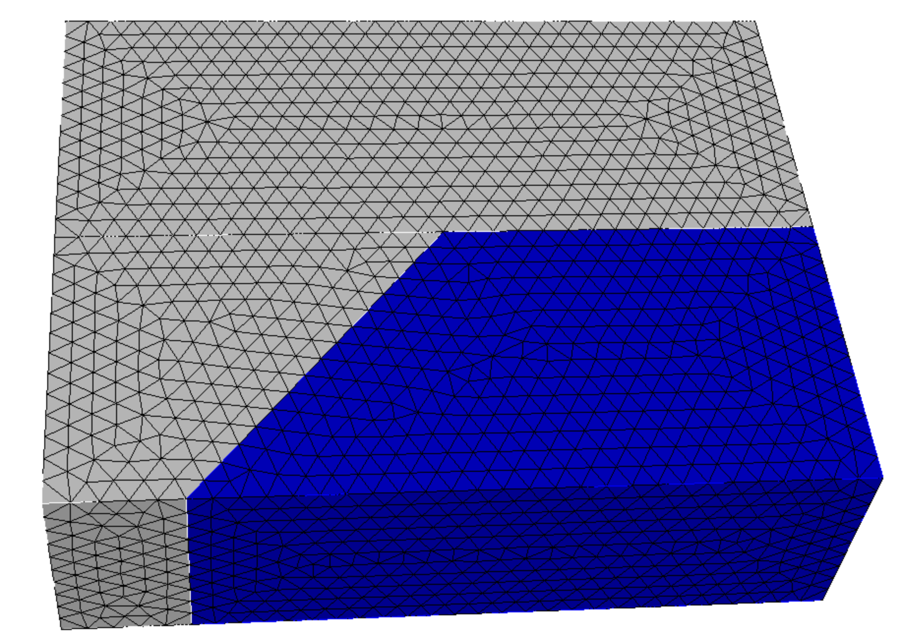
Model set up
Zone 1
Vp1 = 5500 m/s
Vs1 = 3100 m/s
⍴1 = 2700 kg/m³
FaultMod (Barall, 2009)
Uniform traction
Outputs: Slip
Slip rate
Stress
Zone 3
Vp1 = 5500 m/s
Vs1 = 3100 m/s
⍴1 = 2700 kg/m
𝛳 = 50°
Zone 2
Vp2 = Vp1*(1+Ɣ)
Vs2 = Vs1*(1+Ɣ)
⍴2 = ⍴1*(1+Ɣ)
Finite Element mesh

Slide 24
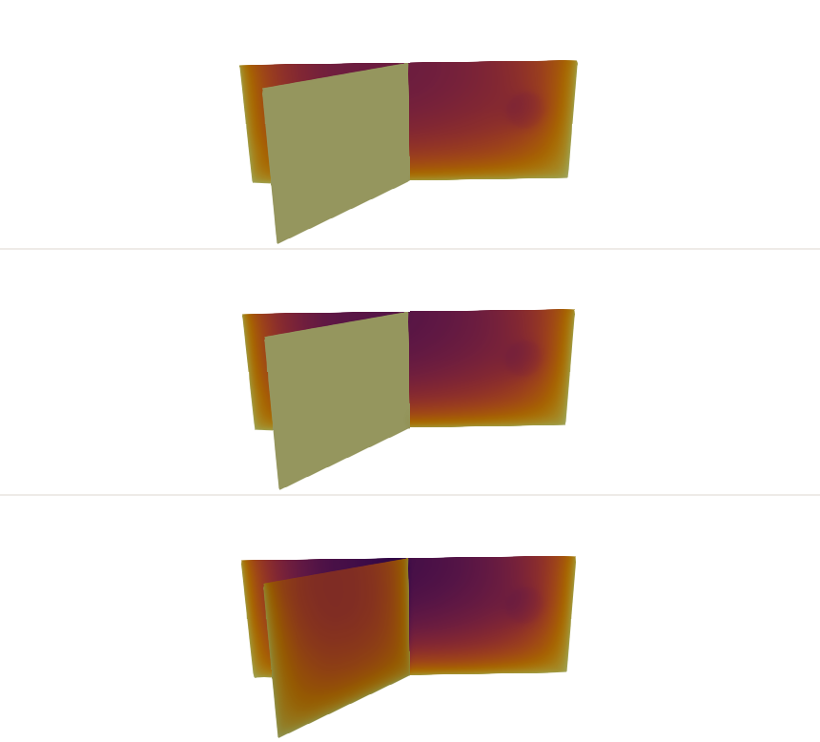
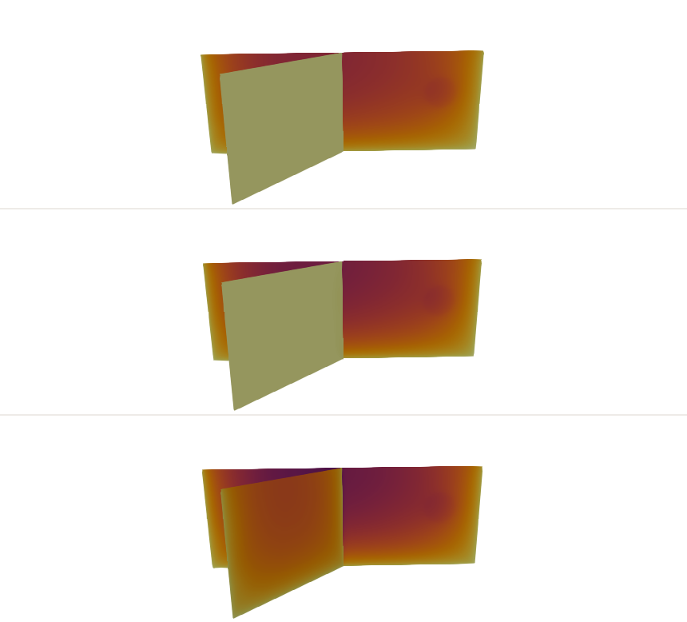
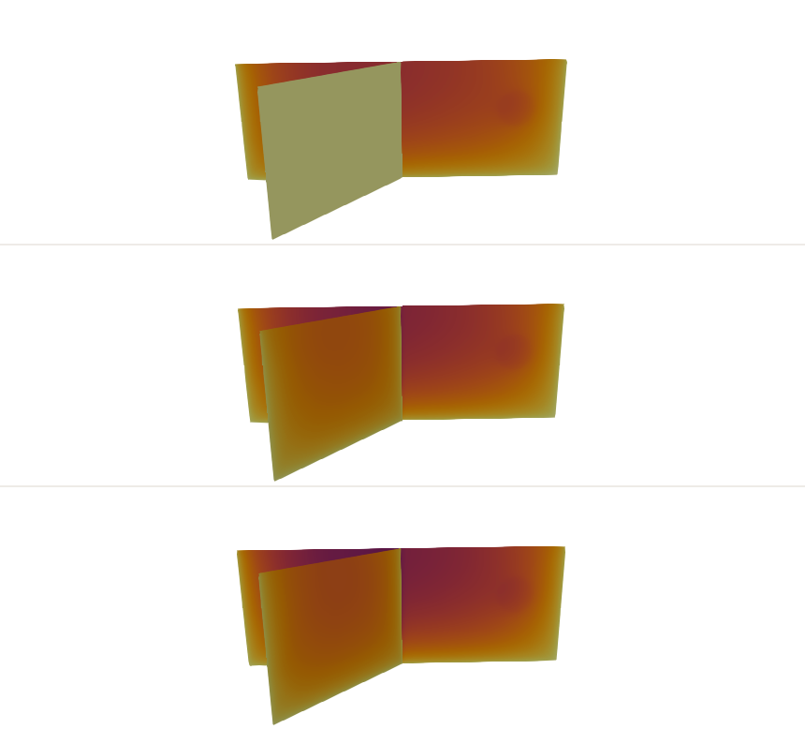
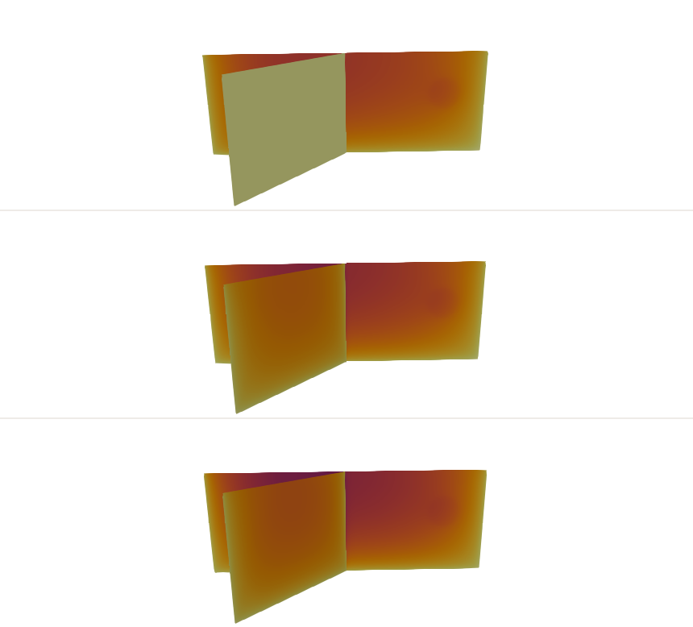
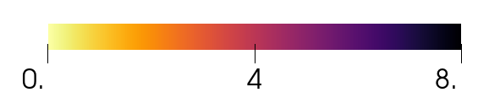
Results: Main Fault Right Lateral, Branch Left Lateral
Material contrast
0%
10%
15%
20%
7.50 MPa
As material contrast increases, the branch becomes more favorable to rupture.
8.00 MPa
Shear Stress
8.50MPa
Slip (m)

Slide 25
Results: Main Fault Right Lateral, Branch Left Lateral
Material contrast
0%
10%
15%
20%
7.50 MPa
As material contrast increases, the branch becomes more favorable to rupture.
8.00 MPa
Shear Stress
8.50MPa
Slip (m)

Slide 26
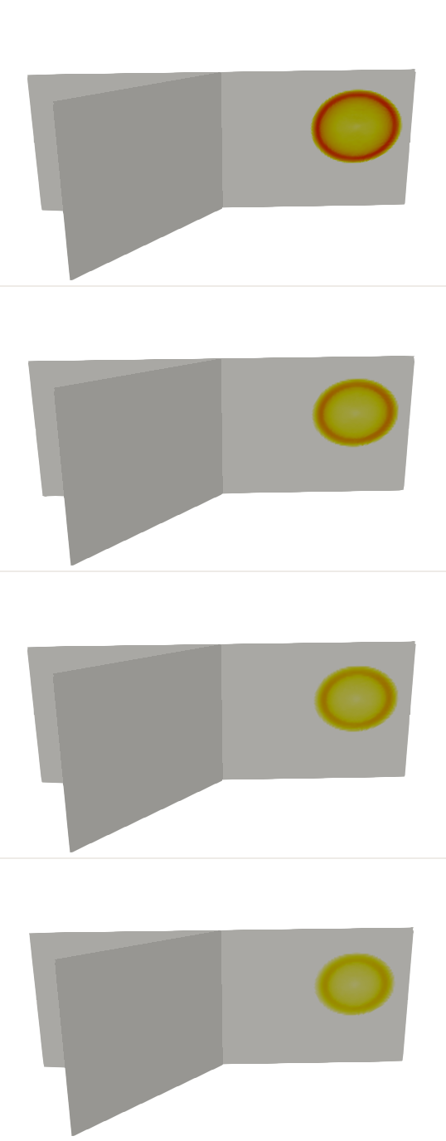
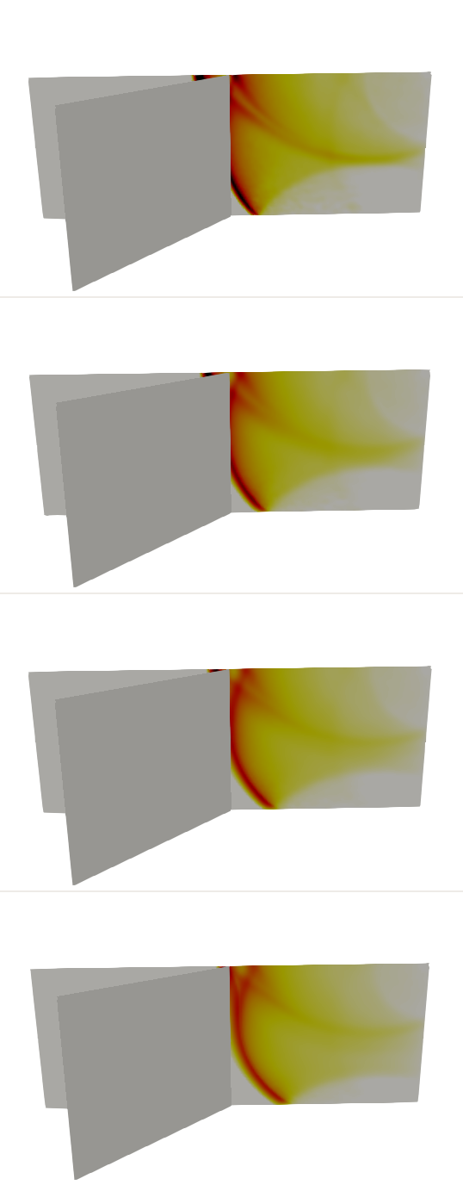
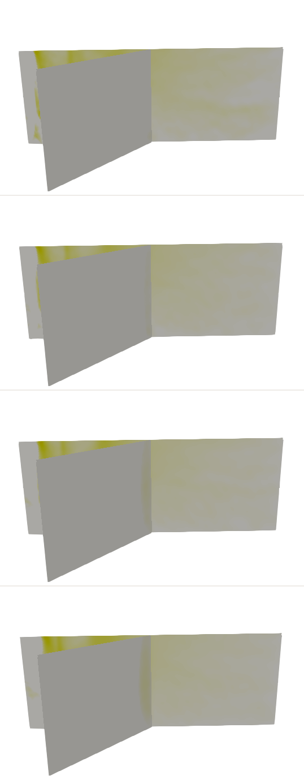
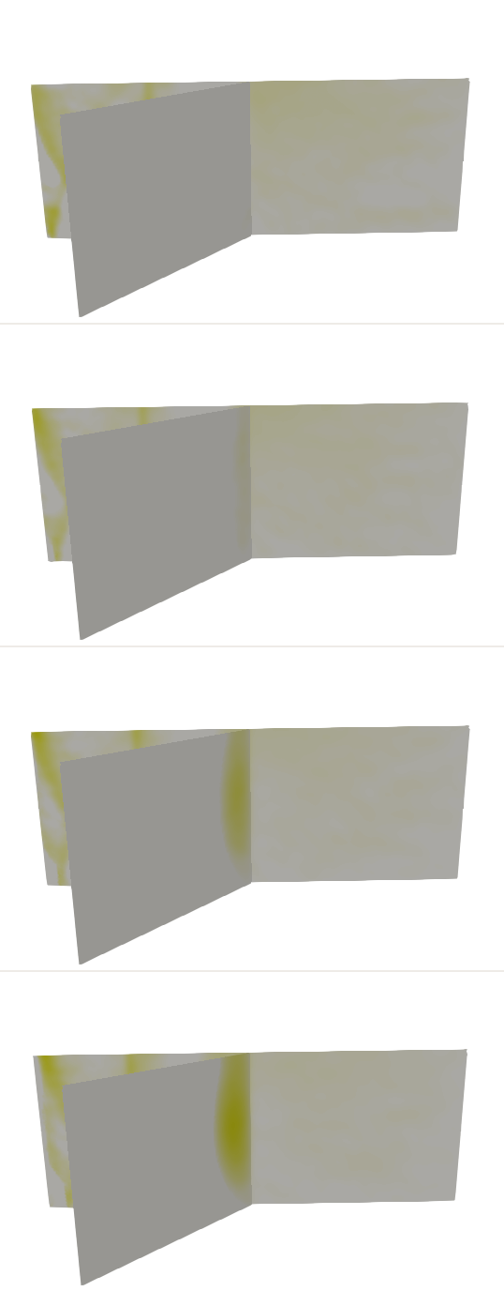
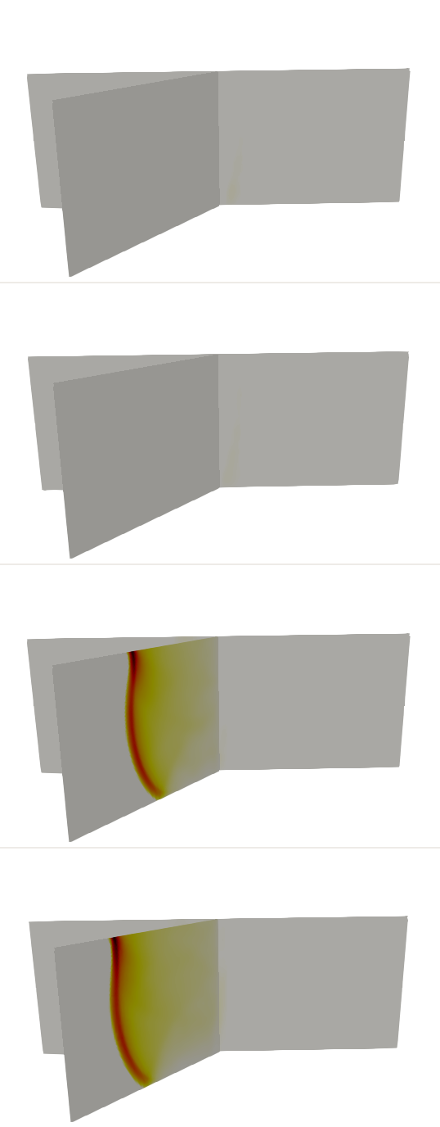
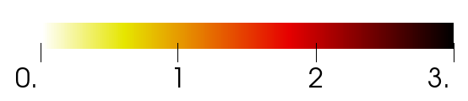
Sliprate evolution, backwards branching
T = 2 s
T = 6 s
T = 12 s
T = 13 s
T = 17 s
0%
10%
Material Contrast
15%
20%
Slip Rate (m/s)

Slide 27
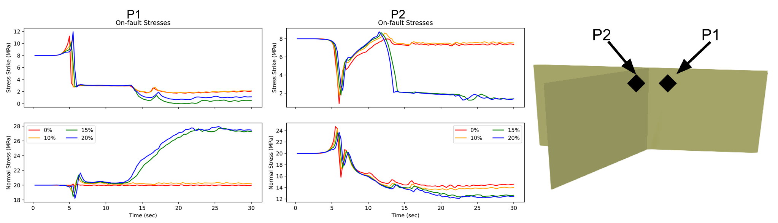
Looking at the stress
Larger shear stress increase on branch
Bimaterial induced normal stress perturbation
Larger normal stress reduction on branch

Slide 28
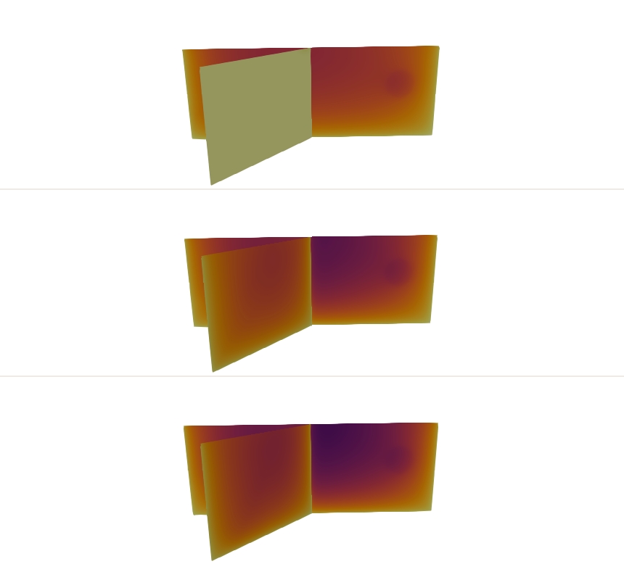
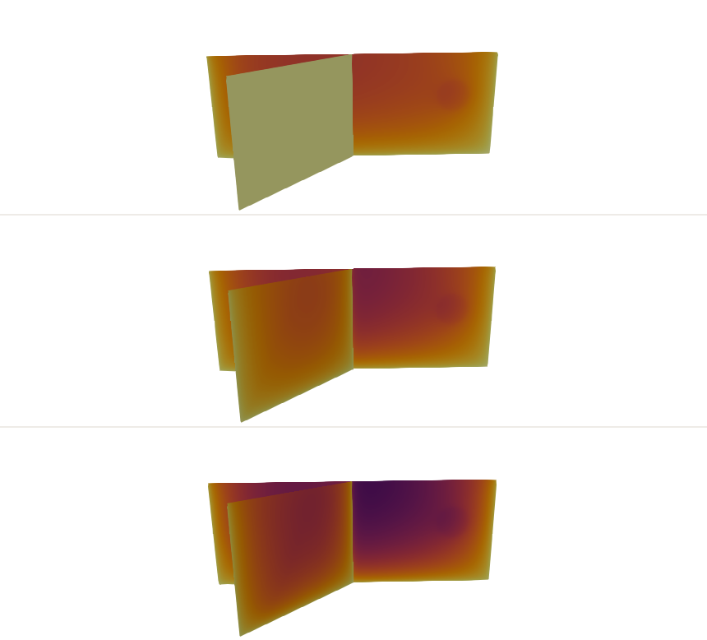
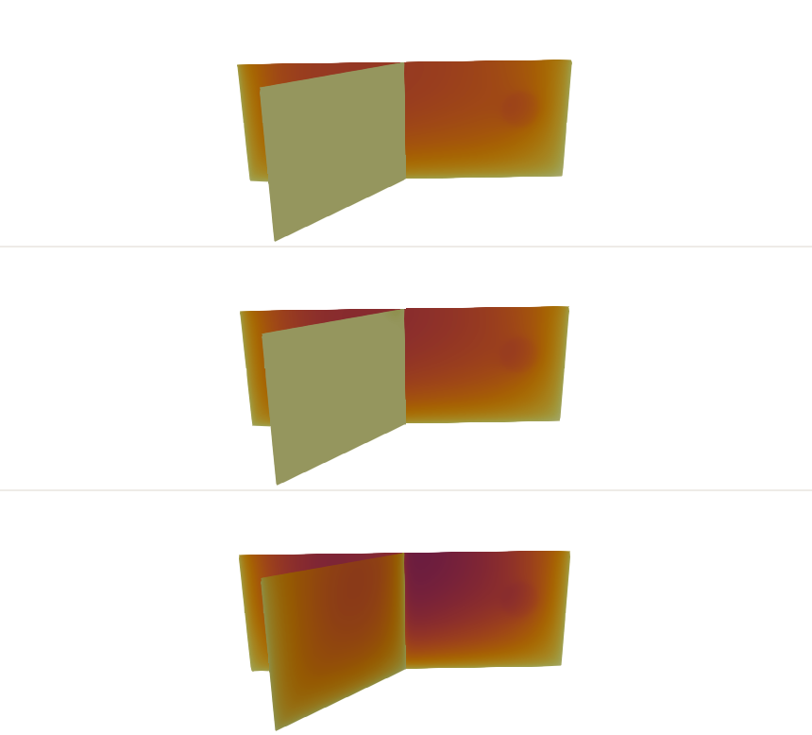
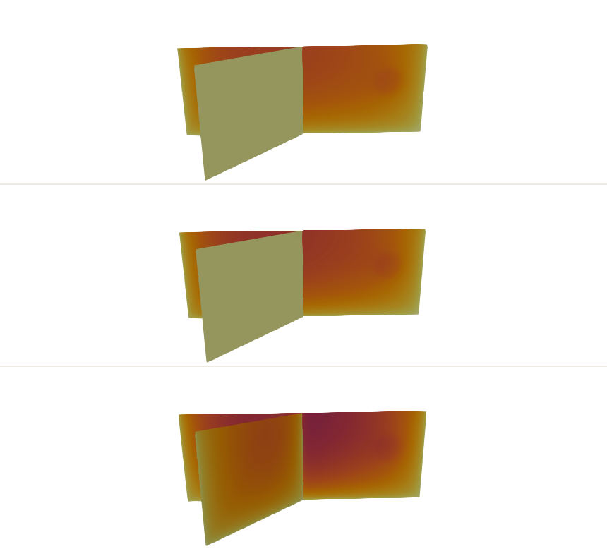
Results: Main Fault Right Lateral, Branch Right Lateral
Material contrast
0%
10%
15%
20%
7.00 MPa
As material contrast increases, the branch becomes less favorable to rupture.
7.50 MPa
Shear Stress
8.00MPa
Slip (m)

Slide 29
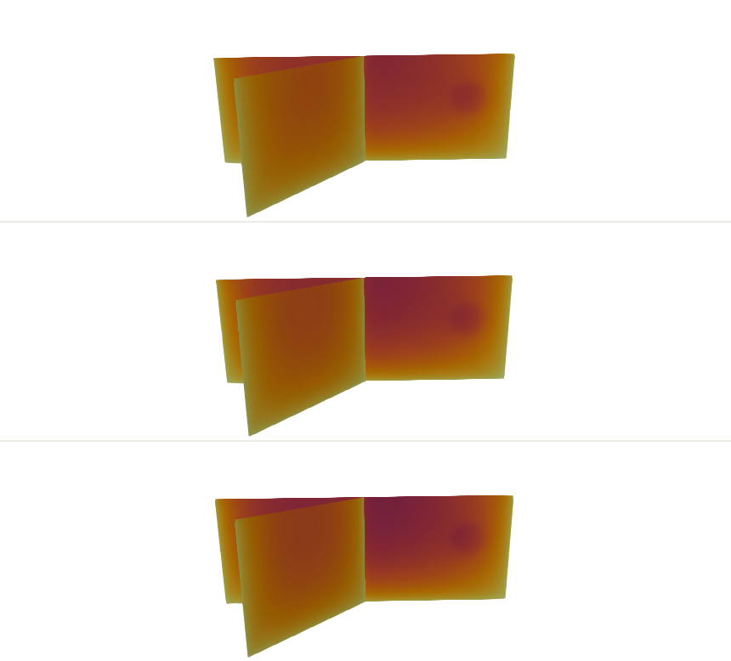

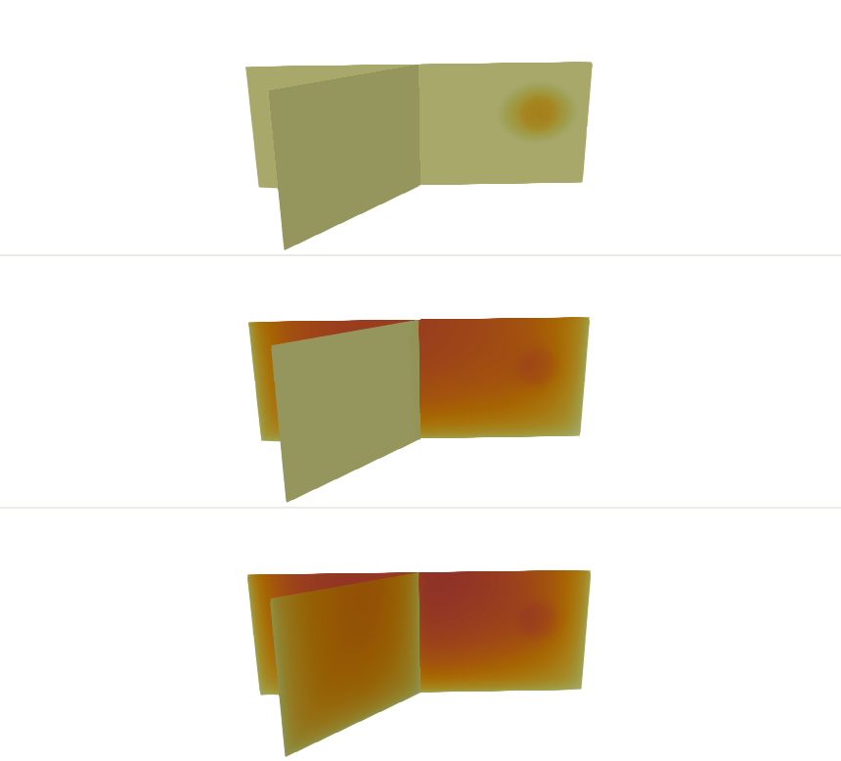
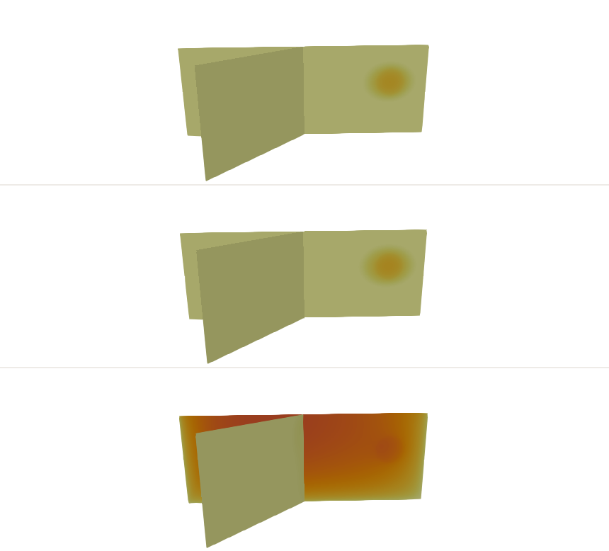
Results: Main Fault Left Lateral, Branch Left Lateral
Material contrast
0%
10%
15%
20%
6.50 MPa
As material contrast increases, the branch becomes less favorable to rupture.
6.75 MPa
Shear Stress
7.00MPa
Slip (m)

Slide 30
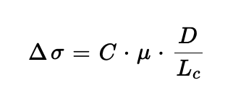
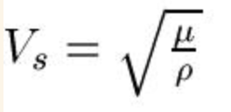
Could the difference be related to shear modulus?
When we vary the velocity we change the elastic moduli.
What if we kept this constant and only varied velocity by changing density?

Slide 31






Main Fault Left Lateral, Branch Left Lateral:
Shear Stress 6.75 Mpa
0%
15%
Material Contrast
DD 15%
Slip Rate (m/s)
Slip (m)
Only changing density

Slide 32
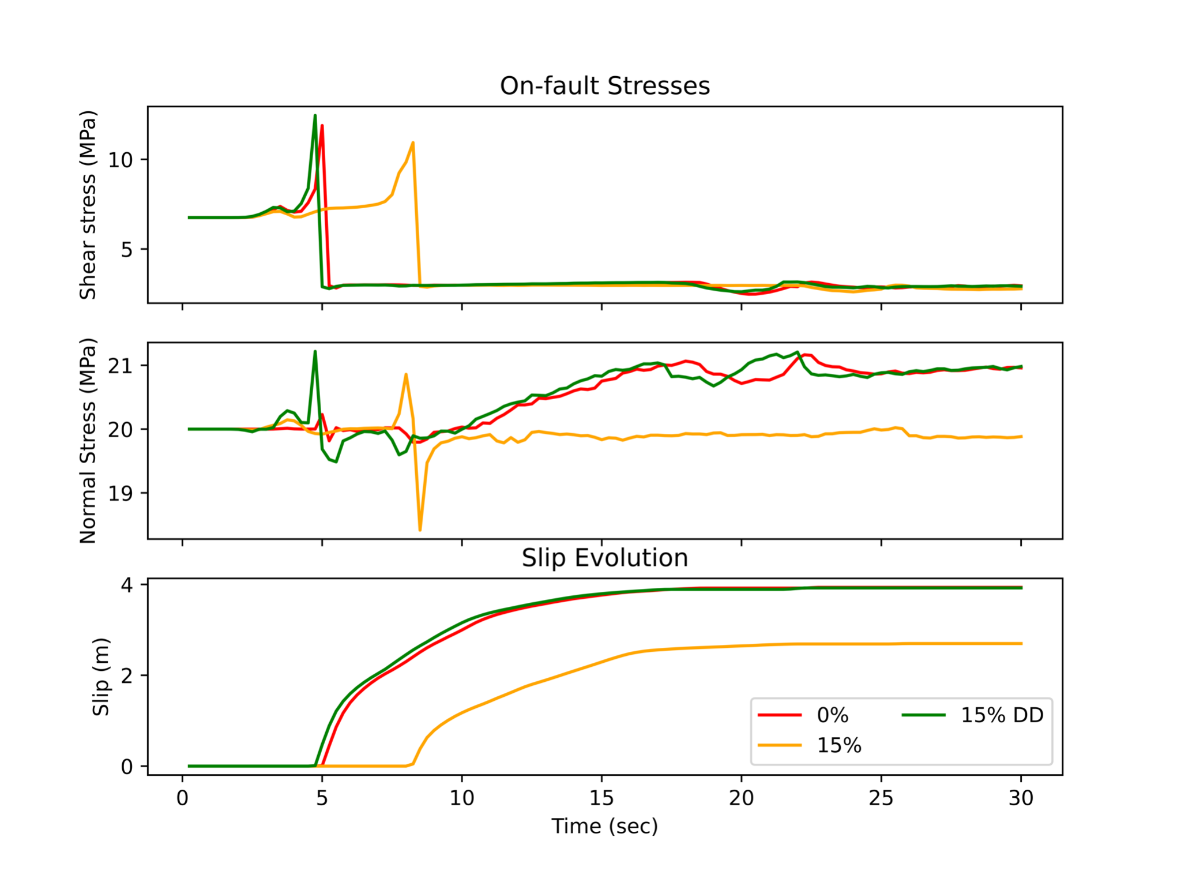
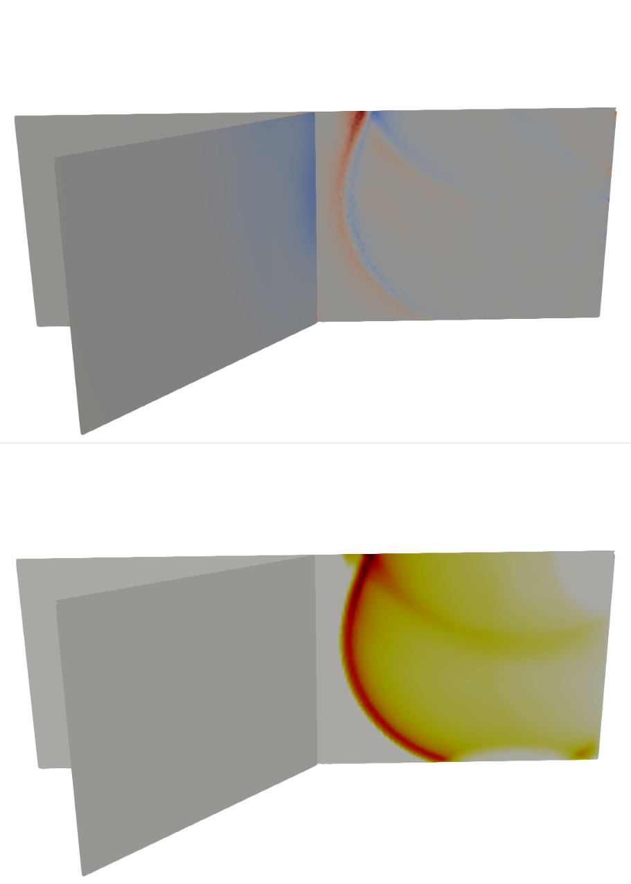
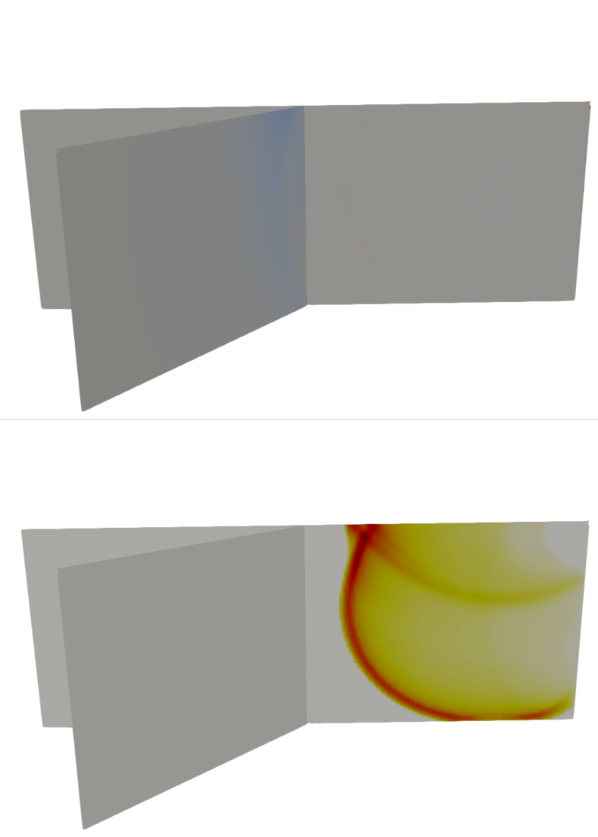
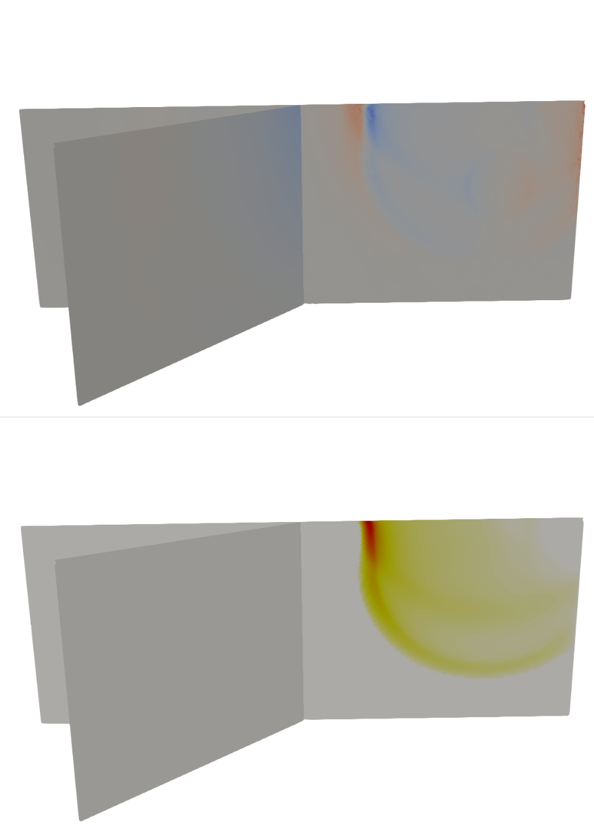
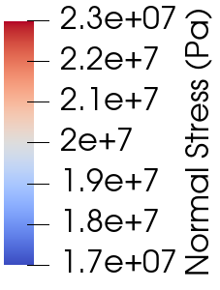
A closer look on the fault
15% DD T = 5.5 s
0%
T = 5.5 s
15%
T = 8.5 s
Normal stress perturbations
Slip Rate (m/s)

Slide 33
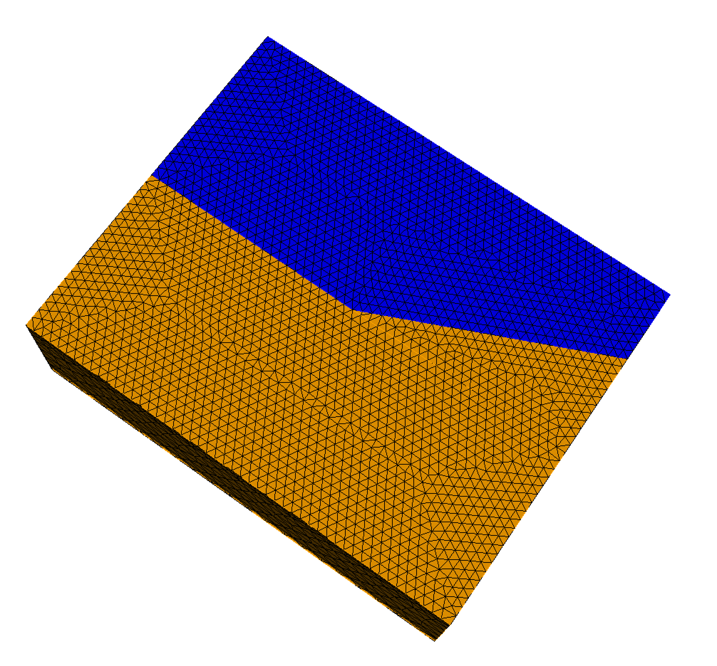
Sensitivity to other parameters: Branch angle
Recall: branch angle has a strong influence on rupture behavior.
So we test smaller angles, decreasing the branch angle from 50° to 25°.
Aochi et al, 2000

Slide 34
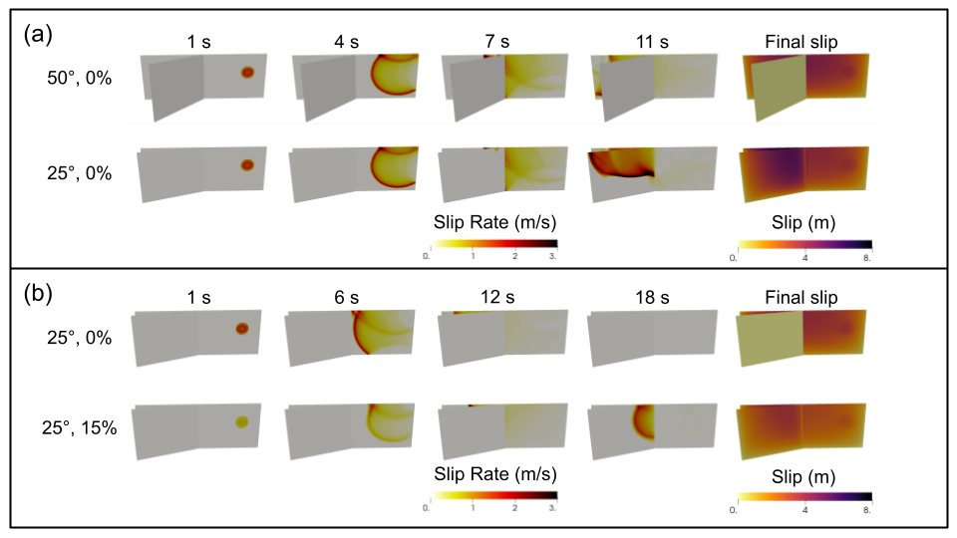
Sensitivity to other parameters: Branch angle
Main right lateral, Branch left lateral. Normal stress 20 MPa
Shear stress 7.5 MPa
Shear stress 7.0 MPa

Slide 35
Sensitivity to other parameters: Branch angle
Main right lateral, Branch left lateral. Normal stress 20 MPa
Shear stress 7.5 MPa
Shear stress 7.0 MPa
Narrow angle promotes rupturing secondary segment
Increased material contrast promotes rupture on secondary fault

Slide 36
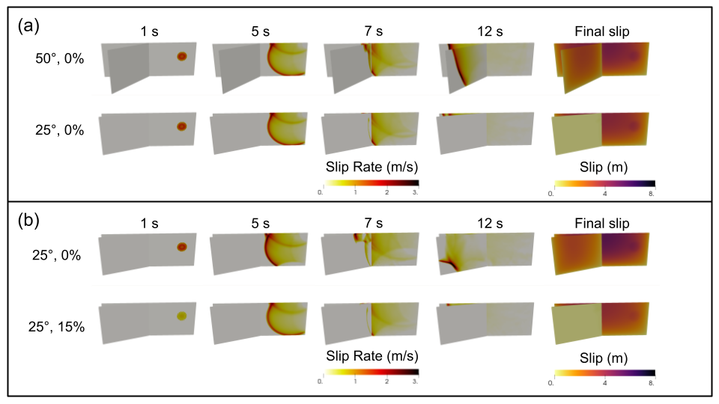
Sensitivity to other parameters: Branch angle
Main left lateral, Branch left lateral. Normal stress 20 MPa
Shear stress 7.0 MPa
Shear stress 7.75 MPa

Slide 37
Sensitivity to other parameters: Branch angle
Main left lateral, Branch left lateral. Normal stress 20 MPa
Shear stress 7.0 MPa
Shear stress 7.75 MPa
Narrow angle hinders rupturing secondary segment
Increased material contrast hinders rupture on secondary fault

Slide 38
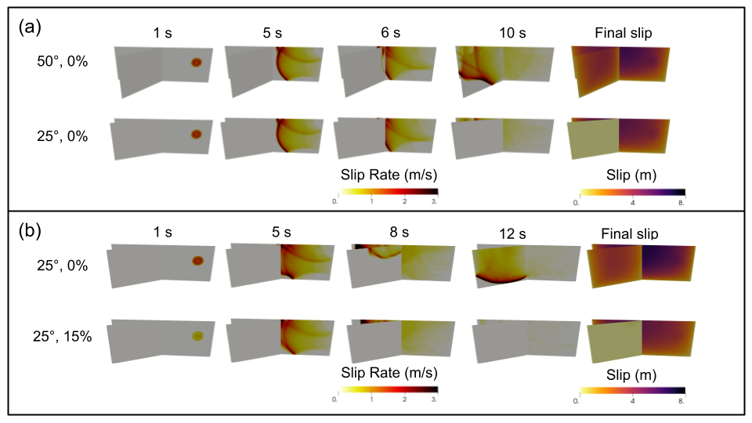
Sensitivity to other parameters: Branch angle
Main right lateral, Branch right lateral. Normal stress 20 MPa
Shear stress 8.0 MPa
Shear stress 9.0 MPa

Slide 39
Sensitivity to other parameters: Branch angle
Main right lateral, Branch right lateral. Normal stress 20 MPa
Shear stress 8.0 MPa
Shear stress 9.0 MPa
Narrow angle hinders rupturing secondary segment
Increased material contrast hinders rupture on secondary fault

Slide 40
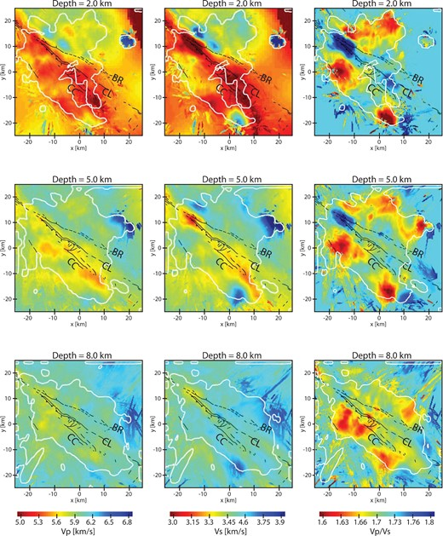
Implications for fault systems in Southern California
Southern San Jacinto Fault is similar to our narrow angle models

Slide 41
Implications for fault systems in Southern California
Southern San Jacinto Fault is similar to our narrow angle models

Slide 42

Implications for fault systems in Southern California
Southern San Jacinto Fault is similar to our narrow angle models
0%
15%
Slip (m)

Slide 43
Implications for fault systems in Southern California
Southern San Jacinto Fault is similar to our narrow angle models
0%
Clark (CL) fault may be favoured or Buck Ridge (BR)
15%
Slip (m)

Slide 44
Conclusions and next steps
A bimaterial interface can cause differences in rupture behavior at branch intersections.
The shear modulus seems to influence this effect more than the wave speed in the medium.
May have implications for complex fault systems which separate lithologies.
Might test sensitivity to other friction laws?
Would depth dependent stresses amplify or reduce this effect?
What if the faults are buried?

